Slide 1

50.039 Theory and Practice of Deep Learning W12S2 Introduction to Reinforcement Learning
Matthieu De Mari, Berrak Sisman

Slide 2
About this week (Week 12)
What is Reinforcement Learning?
What are the key ideas behind reinforcement learning and its framework?
What is the exploration vs. exploitation tradeoff?
How do we train an RL agent by exploring, then progressively exploiting?
What are some advanced strategies in multi-arm bandit problems?
What are the Q and V functions for a RL problem?
What is Q-learning and how can it be implemented in RL problems?

Slide 3
About this week (Week 12)
What is Deep Q Learning? And which problem does it address?
What is a trainer and a main Q-network? What is the interleaved training for Deep Q learning?
What are actor-critic learning methods? And which problems do these approaches address?
What are more advanced problems in RL?
Markov states
Partially observable environment
SARSA
Non-stationary problems

Slide 4
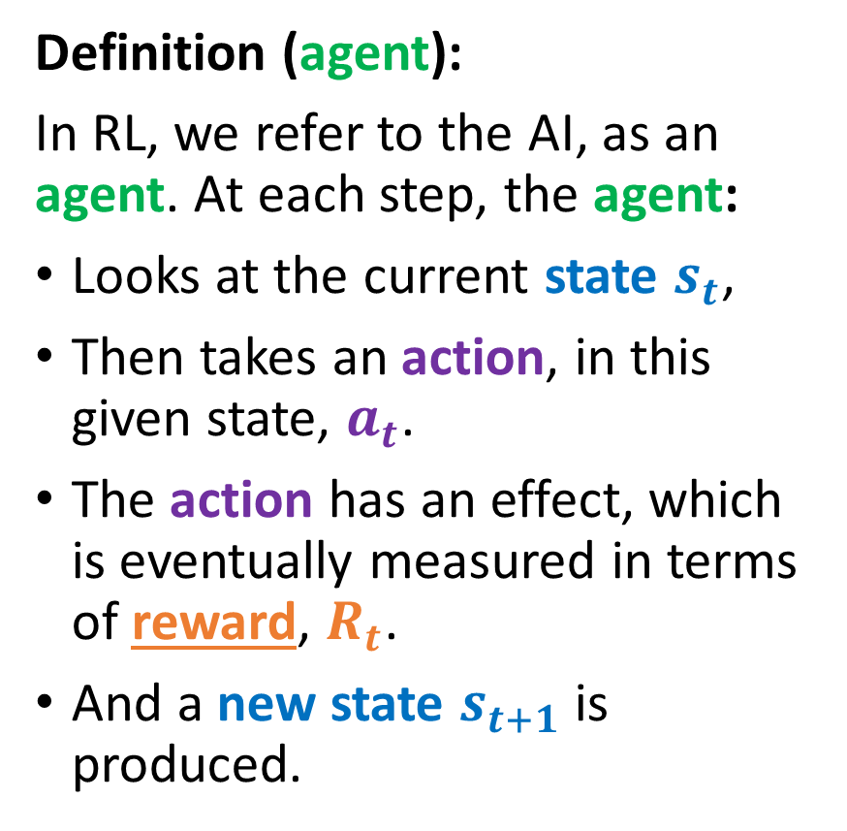
Reusing the RL formalism
Definition (agent):
In RL, we refer to the AI, as an agent. At each step, the agent:
Looks at the current state $s_{t}$,
Then takes an action, in this given state, $a_{t}$.
The action has an effect, which is eventually measured in terms of reward, $R_{t}$.
And a new state $s_{t+1}$ is produced.
State $s_{t}$
State 𝒔_𝒕
Take action based on state $a_{t}$
Take action based on state 𝒂_𝒕
Reward $R_{t}\left(a_{t}, s_{t}\right)$ is given for taking action in said state
Reward 𝑹_𝒕 (𝒂_𝒕, 𝒔_𝒕 ) is given for taking action in said state
Environment changes and a new state $s_{t+1}$ is produced
Environment changes and a new state 𝒔_(𝒕+𝟏) is produced

Slide 5
Exploration and exploitation tradeoff
Definition (exploration and exploitation):
The phase during which, you try out things to acquire knowledge about the problem is called exploration.
The second phase, where you rely on your acquired knowledge, and play what you feel is the best move, is called exploitation.
Definition (exploration vs. exploitation tradeoff):
A good RL-based AI, needs to smartly combine exploration and exploitation phases.
Too much exploration? You have wasted coins trying out bad machines.
No enough exploration? You might end up choosing the wrong machine as the “best” one.

Slide 6
A second toy problem
The Maze problem

Slide 7
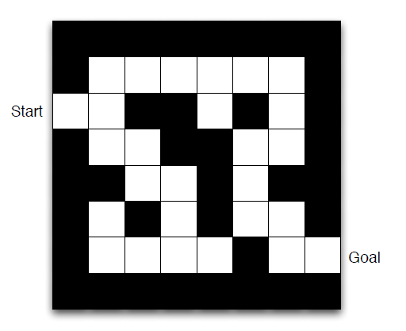
The maze problem
Let us consider the maze problem, described on the right.
The objective is
to find the shortest path between the start and goal squares,
without any knowledge of what the maze is beforehand.

Slide 8
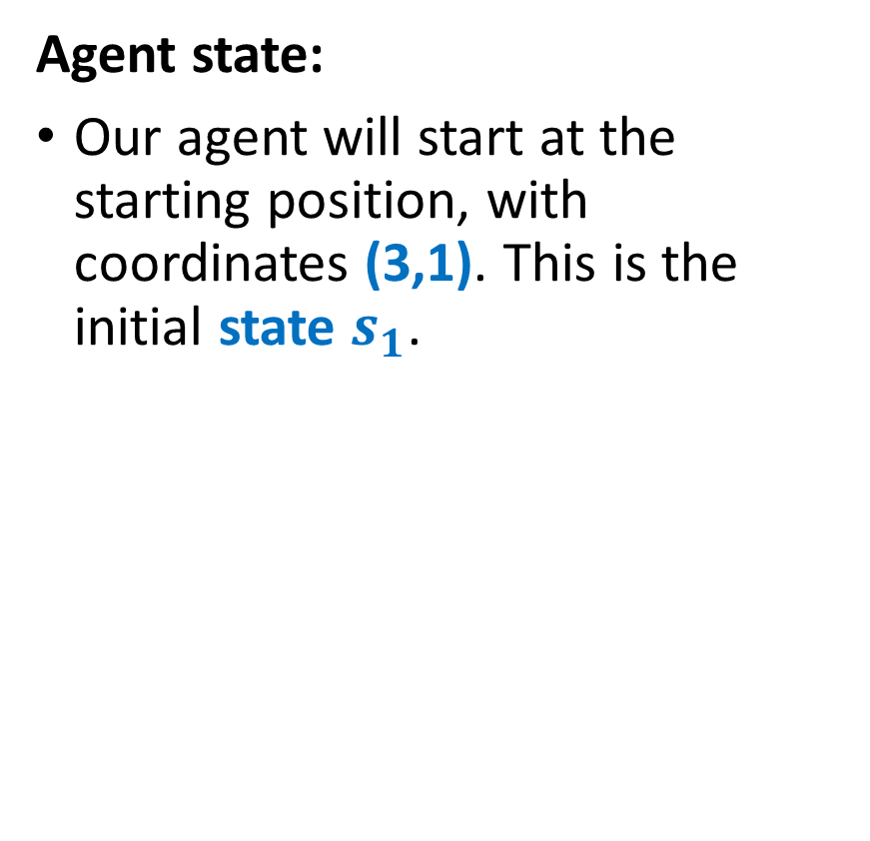
The maze problem
Agent state:
Our agent will start at the starting position, with coordinates (3,1). This is the initial state $s_{1}$.

Slide 9
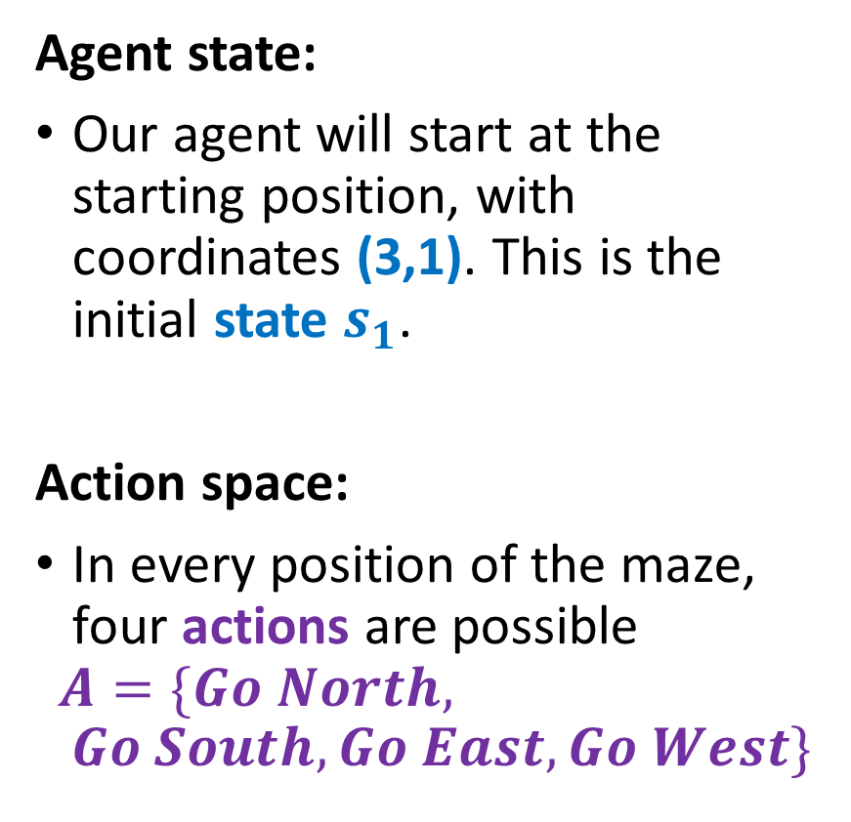
The maze problem
Agent state:
Our agent will start at the starting position, with coordinates (3,1). This is the initial state $s_{1}$.
Action space:
In every position of the maze, four actions are possible
$$A=\{Go North, Go South,Go East,Go West\}$$

Slide 10
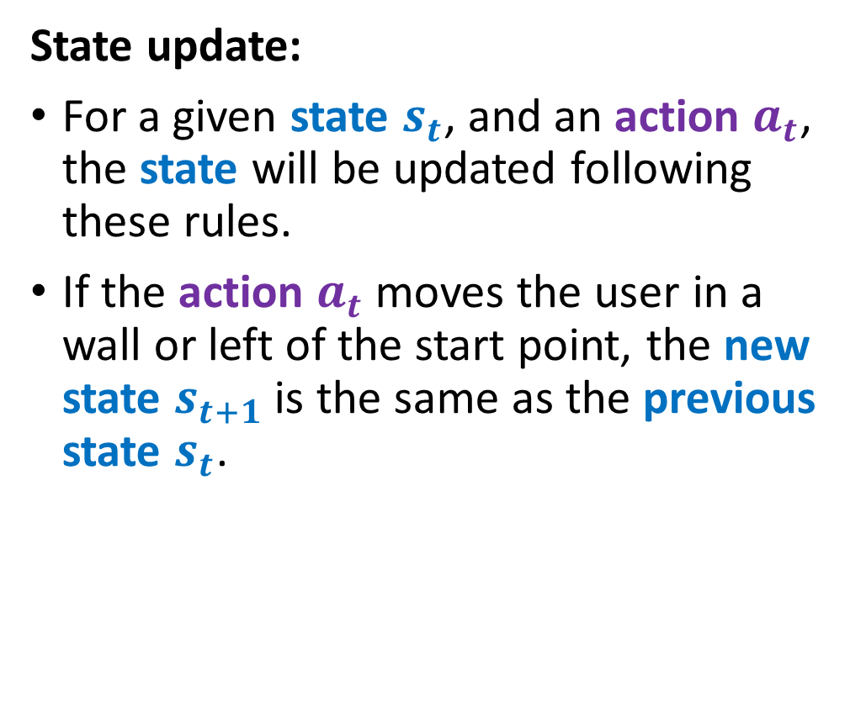
The maze problem
State update:
For a given state $s_{t}$, and an action $a_{t}$, the state will be updated following these rules.
If the action $a_{t}$ moves the user in a wall or left of the start point, the new state $s_{t+1}$ is the same as the previous state $s_{t}$.

Slide 11
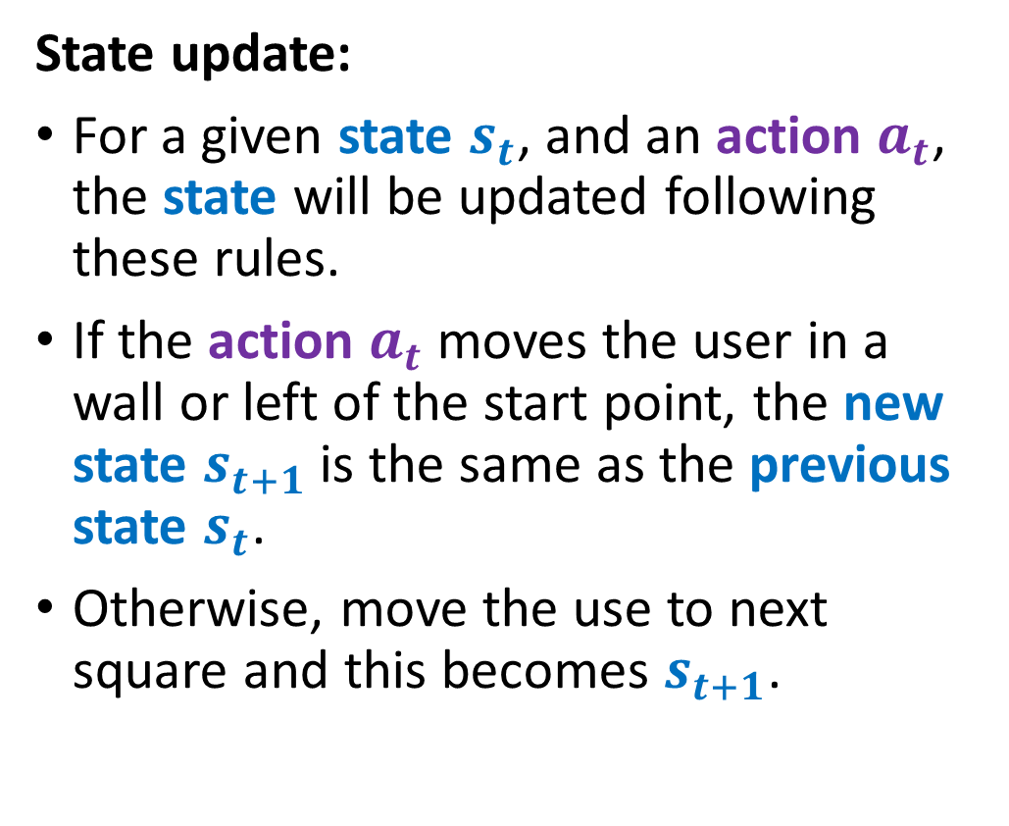
The maze problem
State update:
For a given state $s_{t}$, and an action $a_{t}$, the state will be updated following these rules.
If the action $a_{t}$ moves the user in a wall or left of the start point, the new state $s_{t+1}$ is the same as the previous state $s_{t}$.
Otherwise, move the use to next square and this becomes $s_{t+1}$.
$$s_{t}=\left(3,1\right)+a_{t}=East→s_{t+1}=(3,2)$$

Slide 12
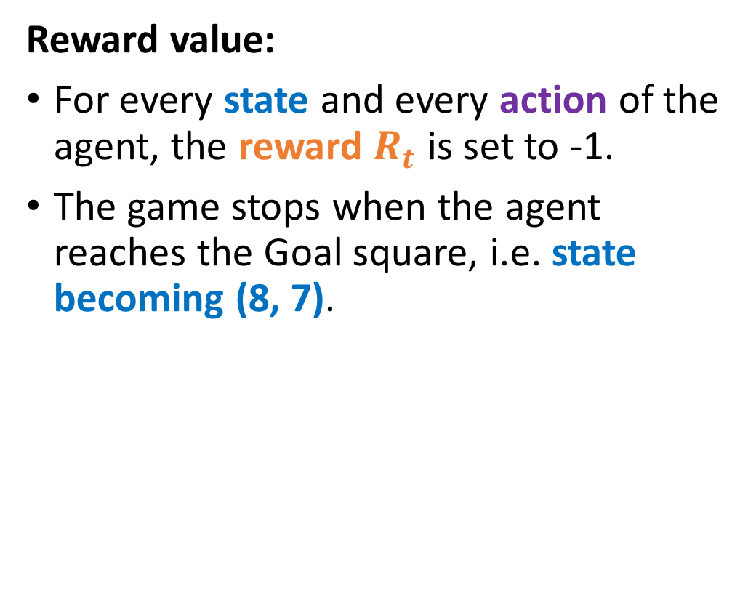
The maze problem
Reward value:
For every state and every action of the agent, the reward $R_{t}$ is set to -1.
The game stops when the agent reaches the Goal square, i.e. state becoming (8, 7).

Slide 13
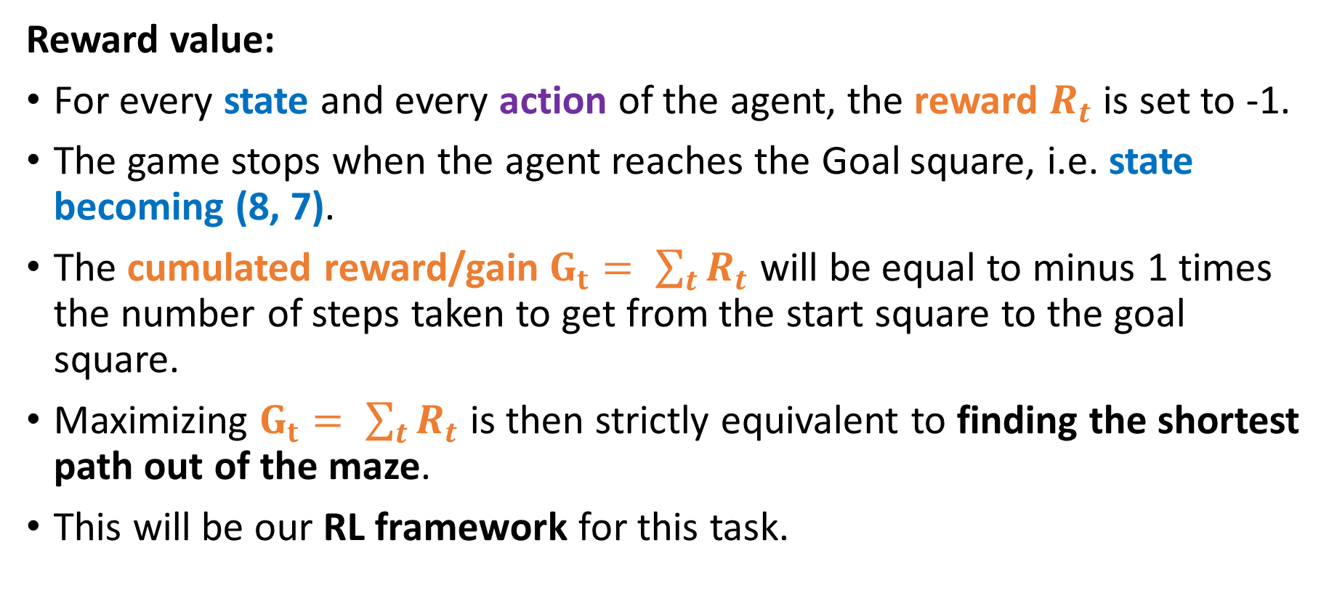
The maze problem
Reward value:
For every state and every action of the agent, the reward $R_{t}$ is set to -1.
The game stops when the agent reaches the Goal square, i.e. state becoming (8, 7).
The cumulated reward/gain $G_{t}= \sum_{t}{R_{t}}$ will be equal to minus 1 times the number of steps taken to get from the start square to the goal square.
Maximizing $G_{t}= \sum_{t}{R_{t}}$ is then strictly equivalent to finding the shortest path out of the maze.
This will be our RL framework for this task.

Slide 14
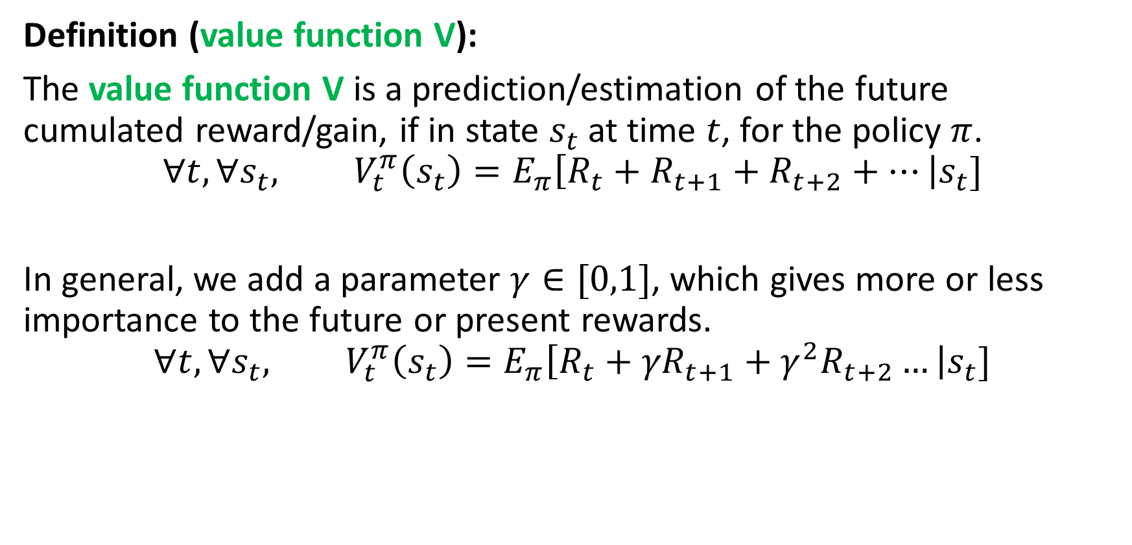
Value function V
Definition (value function V):
The value function V is a prediction/estimation of the future cumulated reward/gain, if in state $s_{t}$at time $t$, for the policy $π$.
$$∀t,∀s_{t}, V_{t}^{π}\left(s_{t}\right)=E_{π}\left[R_{t}+R_{t+1}+R_{t+2}+…\right|s_{t}]$$
In general, we add a parameter $γ∈[0,1]$, which gives more or less importance to the future or present rewards.
$$∀t,∀s_{t}, V_{t}^{π}\left(s_{t}\right)=E_{π}\left[R_{t}+{γR}_{t+1}+γ^{2}R_{t+2}…\right|s_{t}]$$

Slide 15
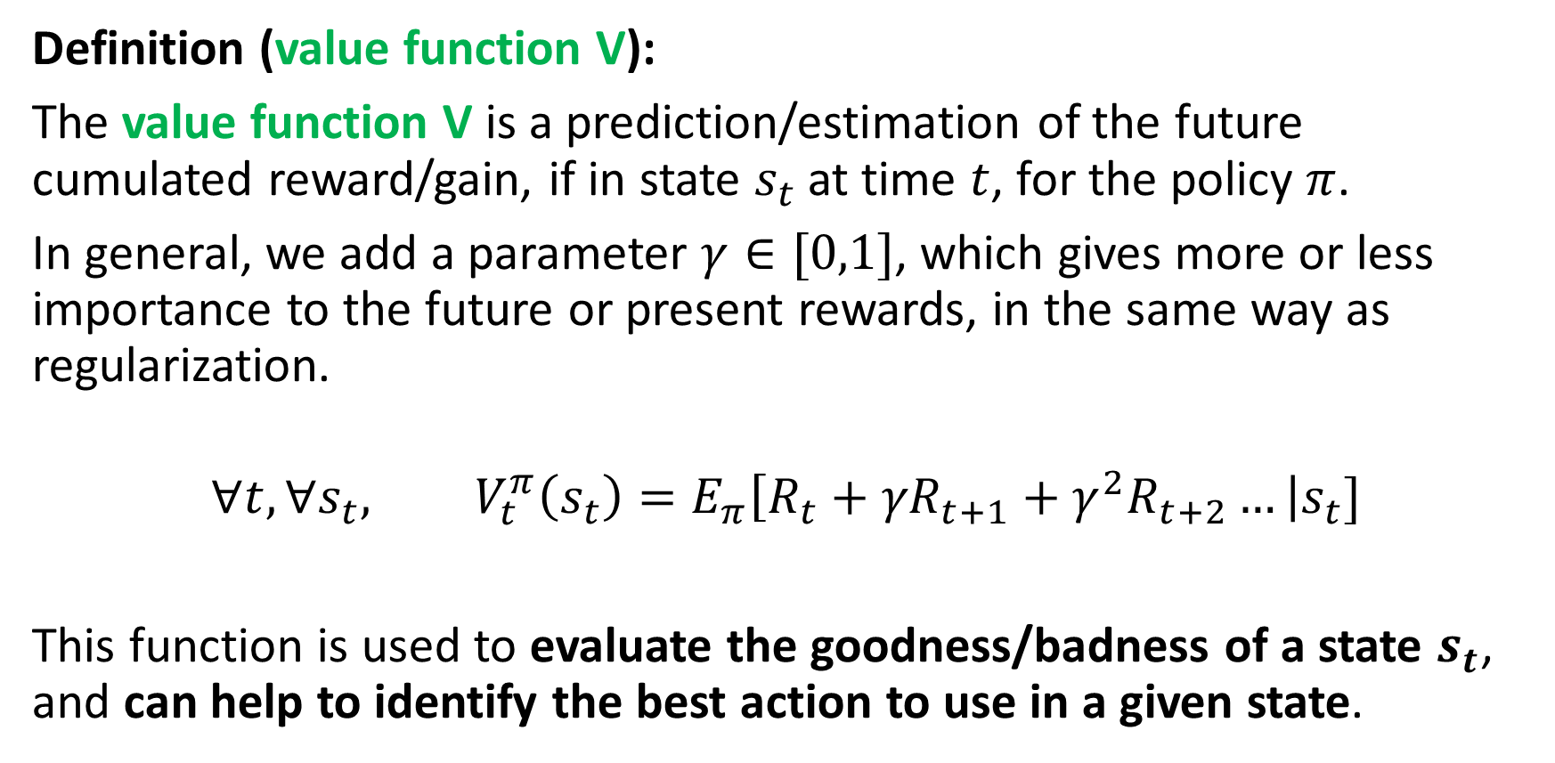
Value function V
Definition (value function V):
The value function V is a prediction/estimation of the future cumulated reward/gain, if in state $s_{t}$at time $t$, for the policy $π$.
In general, we add a parameter $γ∈[0,1]$, which gives more or less importance to the future or present rewards, in the same way as regularization.
$$∀t,∀s_{t}, V_{t}^{π}\left(s_{t}\right)=E_{π}\left[R_{t}+{γR}_{t+1}+γ^{2}R_{t+2}…\right|s_{t}]$$
This function is used to evaluate the goodness/badness of a state $s_{t}$, and can help to identify the best action to use in a given state.

Slide 16
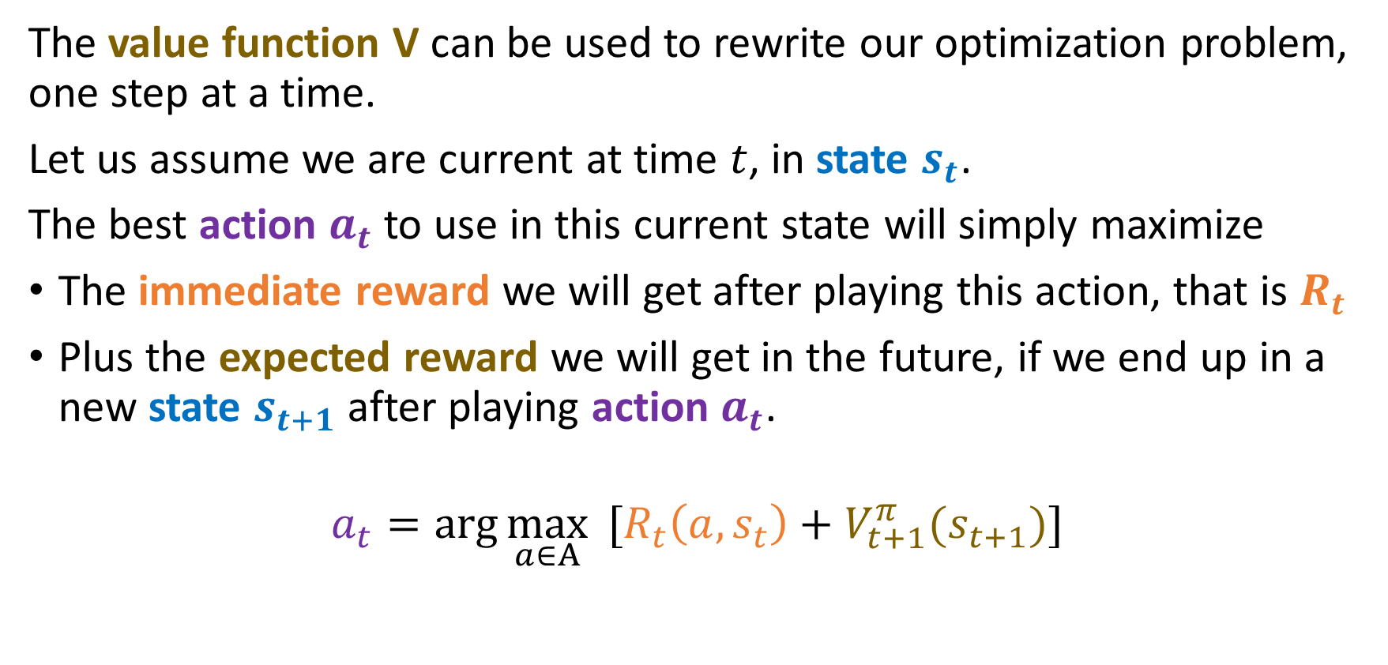
Optimization with value function V
The value function V can be used to rewrite our optimization problem, one step at a time.
Let us assume we are current at time $t$, in state $s_{t}$.
The best action $a_{t}$ to use in this current state will simply maximize
The immediate reward we will get after playing this action, that is $R_{t}$
Plus the expected reward we will get in the future, if we end up in a new state $s_{t+1}$after playing action $a_{t}$.
$$a_{t}=\arg{\max_{a∈A}{ [R_{t}\left(a,s_{t}\right)+V_{t+1}^{π}(s_{t+1})]}}$$

Slide 17
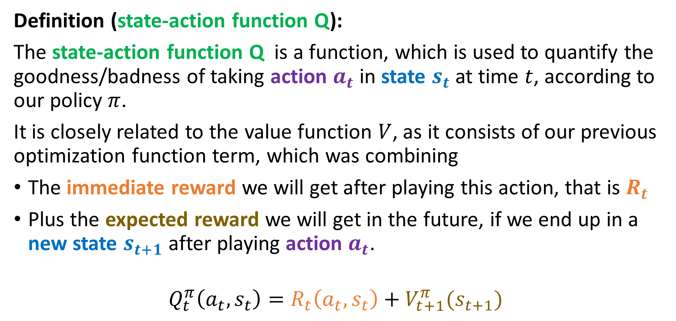
The state-action function Q
Definition (state-action function Q):
The state-action function Q is a function, which is used to quantify the goodness/badness of taking action $a_{t}$ in state $s_{t}$at time $t$, according to our policy $π$.
It is closely related to the value function $V$, as it consists of our previous optimization function term, which was combining
The immediate reward we will get after playing this action, that is $R_{t}$
Plus the expected reward we will get in the future, if we end up in a new state $s_{t+1}$after playing action $a_{t}$.
$$Q_{t}^{π}\left(a_{t},s_{t}\right)=R_{t}\left(a_{t},s_{t}\right)+V_{t+1}^{π}(s_{t+1})$$

Slide 18
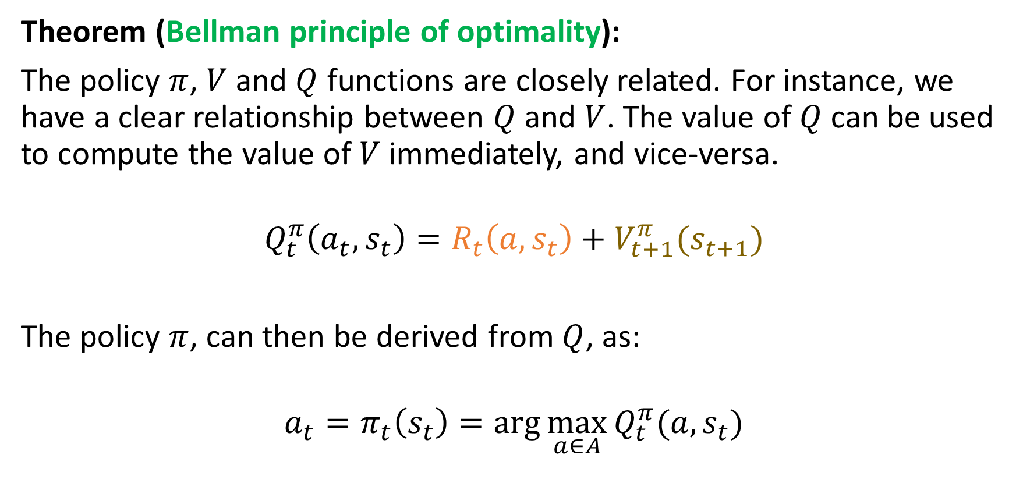
On the policy, V and Q functions relationship
Theorem (Bellman principle of optimality):
The policy $π$, $V$ and $Q$ functions are closely related. For instance, we have a clear relationship between $Q$ and $V$. The value of$Q$can be used to compute the value of $V$ immediately, and vice-versa.
$$Q_{t}^{π}\left(a_{t},s_{t}\right)=R_{t}\left(a,s_{t}\right)+V_{t+1}^{π}(s_{t+1})$$
The policy $π$, can then be derived from $Q$, as:
$$a_{t}=π_{t}\left(s_{t}\right)=\arg{\max_{a∈A}{Q_{t}^{π}(a, s_{t})}}$$

Slide 19
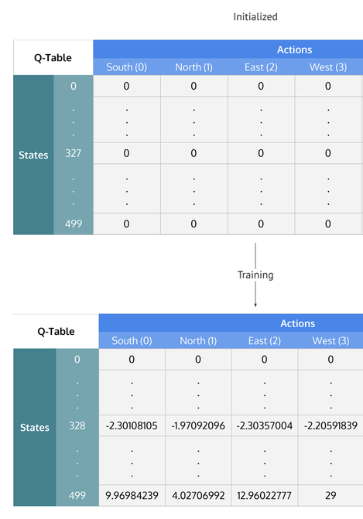
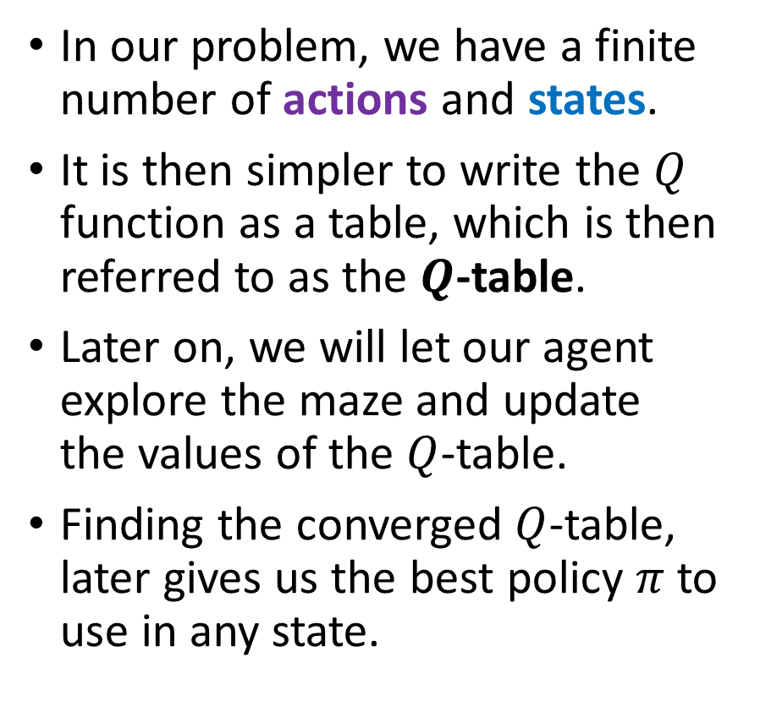
Defining a Q-table
In our problem, we have a finite number of actions and states.
It is then simpler to write the $Q$ function as a table, which is then referred to as the $Q$-table.
Later on, we will let our agent explore the maze and update the values of the $Q$-table.
Finding the converged $Q$-table, later gives us the best policy $π$to use in any state.

Slide 20
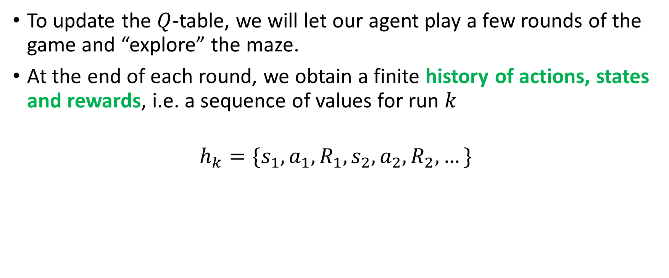
Updating the Q-table via exploration
To update the $Q$-table, we will let our agent play a few rounds of the game and “explore” the maze.
At the end of each round, we obtain a finite history of actions, states and rewards, i.e. a sequence of values for run $k$
$$h_{k}=\{s_{1},a_{1},R_{1},s_{2},a_{2},R_{2},…\}$$

Slide 21
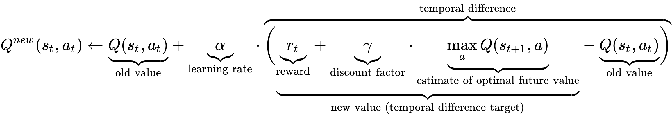
Updating the Q-table via exploration
This sequence can then be used, to update the Q table, according to
In a sense, this formula is the “equivalent” of our gradient descent update, but in the case of reinforcement learning, and is commonly referred to as Q-learning.

Slide 22
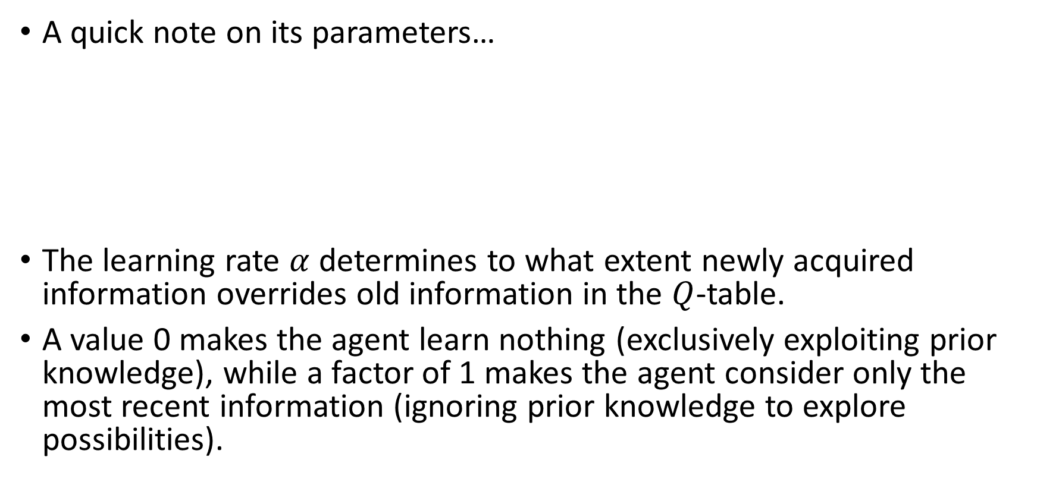
Updating the Q table via exploration
A quick note on its parameters…
The learning rate $α$ determines to what extent newly acquired information overrides old information in the $Q$-table.
A value 0 makes the agent learn nothing (exclusively exploiting prior knowledge), while a factor of 1 makes the agent consider only the most recent information (ignoring prior knowledge to explore possibilities).

Slide 23
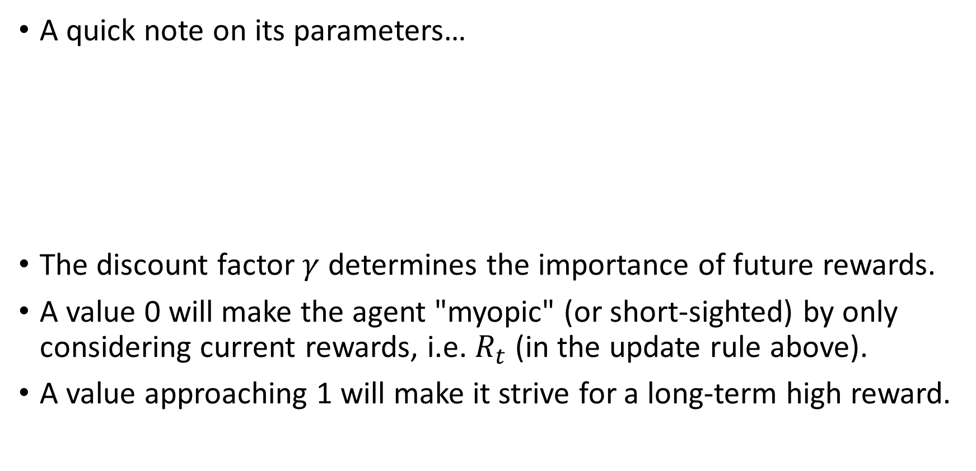
Updating the Q table via exploration
A quick note on its parameters…
The discount factor $γ$ determines the importance of future rewards.
A value 0 will make the agent "myopic" (or short-sighted) by only considering current rewards, i.e. $R_{t}$ (in the update rule above).
A value approaching 1 will make it strive for a long-term high reward.

Slide 24
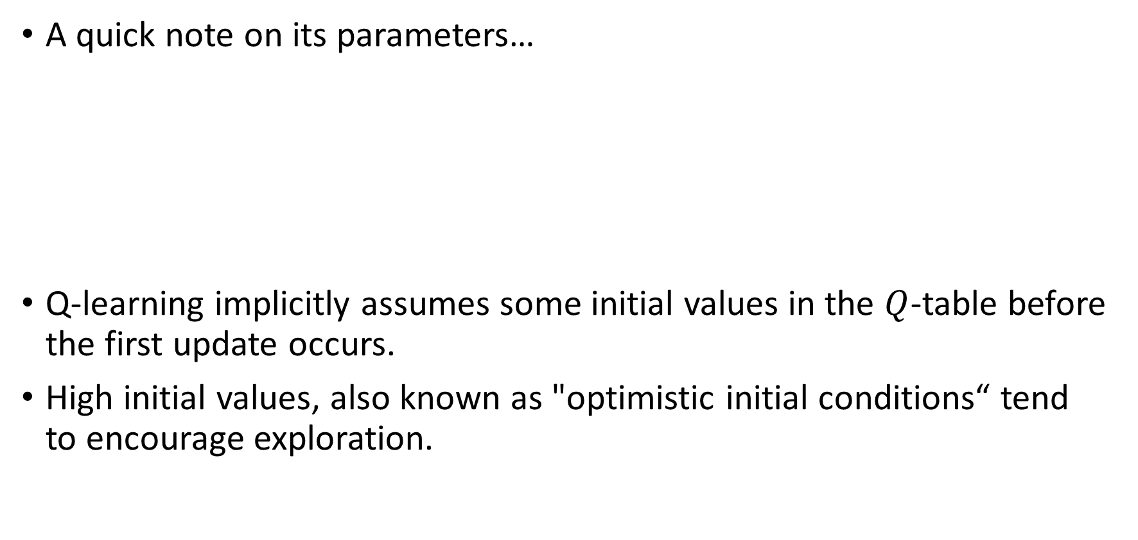
Updating the Q table via exploration
A quick note on its parameters…
Q-learning implicitly assumes some initial values in the $Q$-table before the first update occurs.
High initial values, also known as "optimistic initial conditions“ tend to encourage exploration.

Slide 25
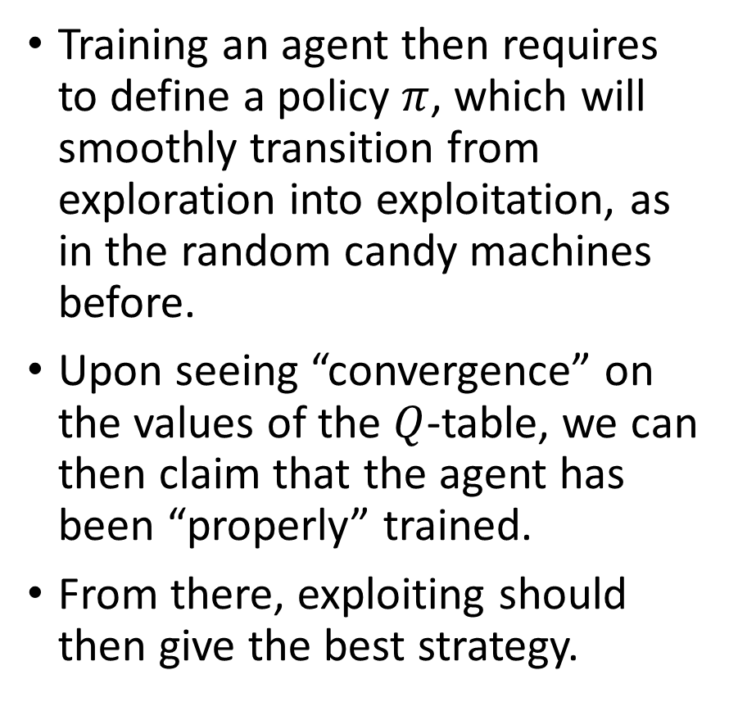
Training an agent
Training an agent then requires to define a policy $π$, which will smoothly transition from exploration into exploitation, as in the random candy machines before.
Upon seeing “convergence” on the values of the $Q$-table, we can then claim that the agent has been “properly” trained.
From there, exploiting should then give the best strategy.

Slide 26
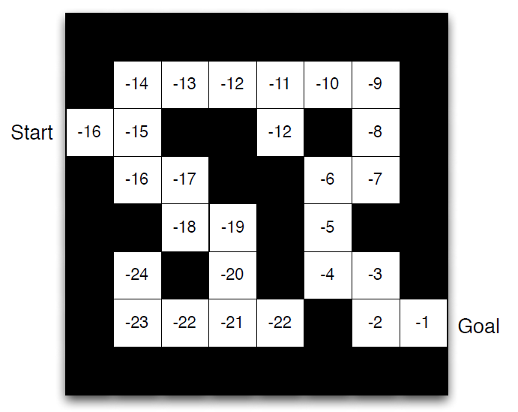
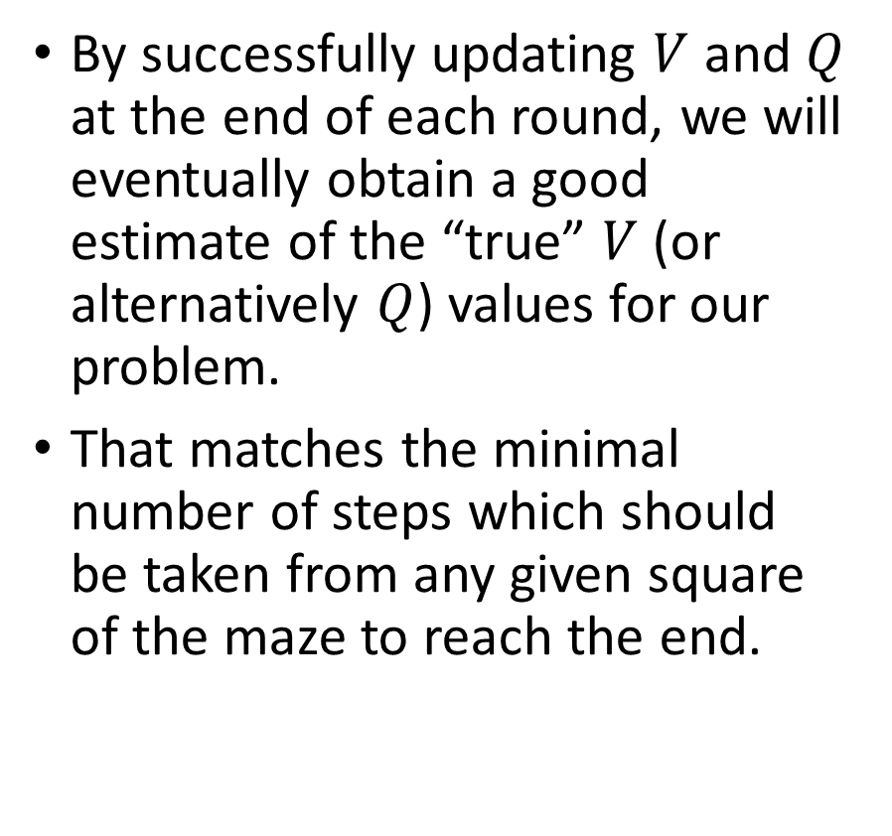
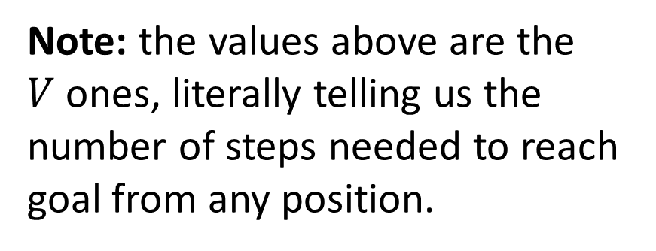
Training an agent
By successfully updating $V$ and $Q$ at the end of each round, we will eventually obtain a good estimate of the “true” $V$ (or alternatively $Q$) values for our problem.
That matches the minimal number of steps which should be taken from any given square of the maze to reach the end.
Note: the values above are the $V$ones, literally telling us the number of steps needed to reach goal from any position.

Slide 27
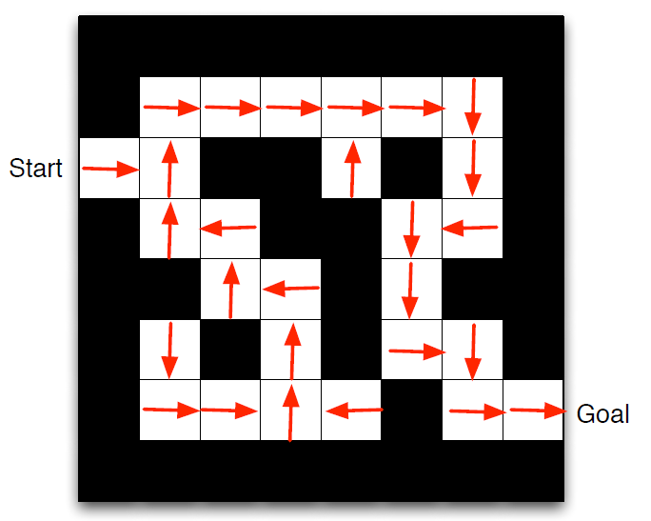
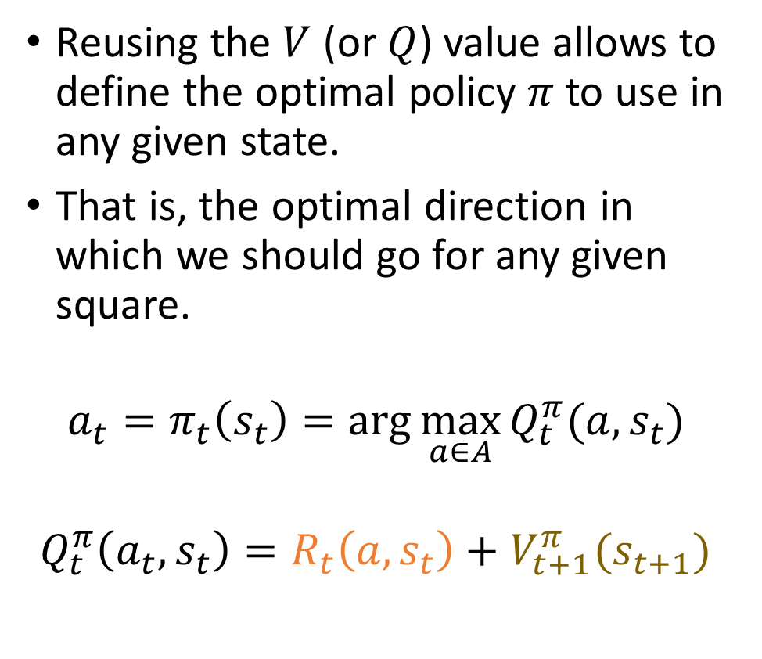
Training an agent
Reusing the $V$ (or $Q$) value allows to define the optimal policy $π$ to use in any given state.
That is, the optimal direction in which we should go for any given square.
$$a_{t}=π_{t}\left(s_{t}\right)=\arg{\max_{a∈A}{Q_{t}^{π}(a, s_{t})}}$$
$$Q_{t}^{π}\left(a_{t},s_{t}\right)=R_{t}\left(a,s_{t}\right)+V_{t+1}^{π}(s_{t+1})$$

Slide 28
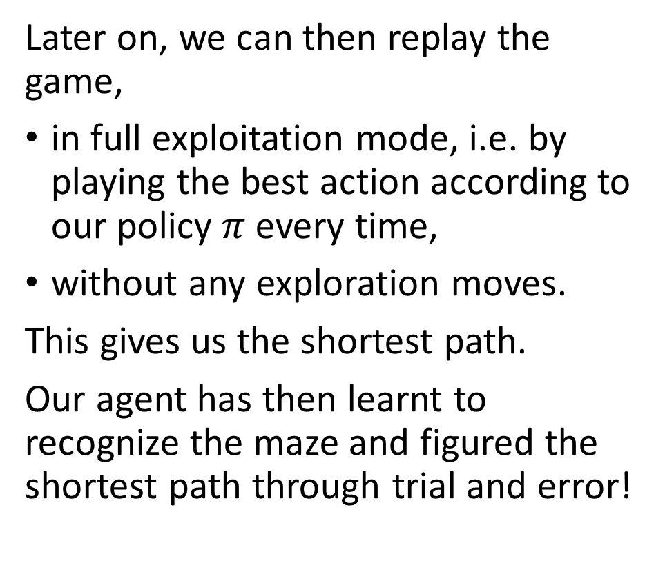
Training an agent
Later on, we can then replay the game,
in full exploitation mode, i.e. by playing the best action according to our policy $π$every time,
without any exploration moves.
This gives us the shortest path.
Our agent has then learnt to recognize the maze and figured the shortest path through trial and error!

Slide 29
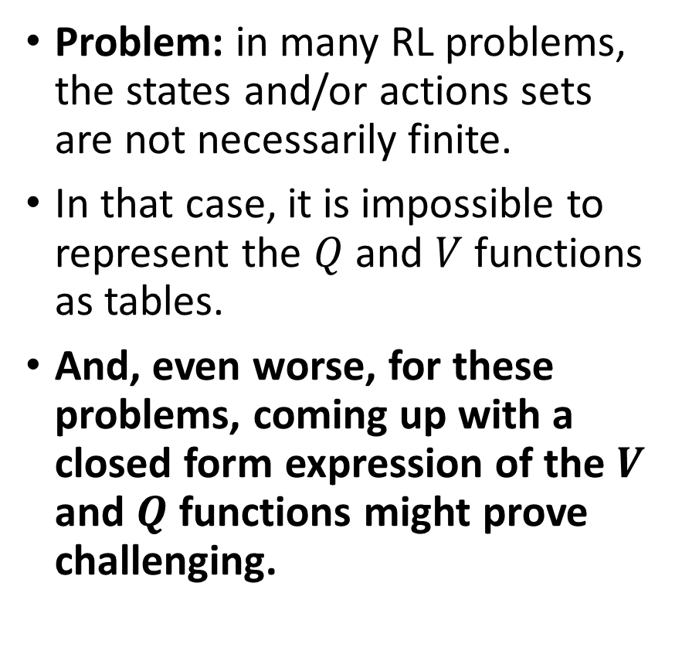
A representation problem
Problem: in many RL problems, the states and/or actions sets are not necessarily finite.
In that case, it is impossible to represent the $Q$ and $V$ functions as tables.
And, even worse, for these problems, coming up with a closed form expression of the $V$ and $Q$ functions might prove challenging.

Slide 30
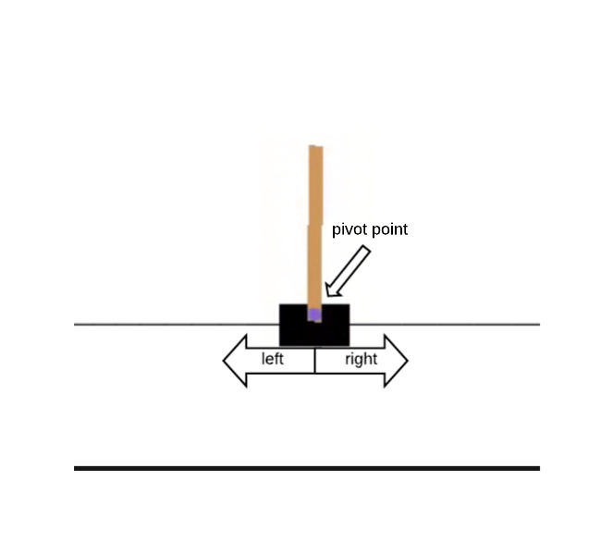
Toy example #3 (shown, but implementation out of the scope of this class)
Example: the cart-pole problem.
State: our current visualization of the cart (i.e. an image).
Actions: 2 of them, go left or go right at a fixed speed.
Reward: +1 for each unit of time where the cart does not leave the screen and the pole does not fall below a certain angle.
Next state generation: cart and pole both follow simple programmed rules of physics.

Slide 31
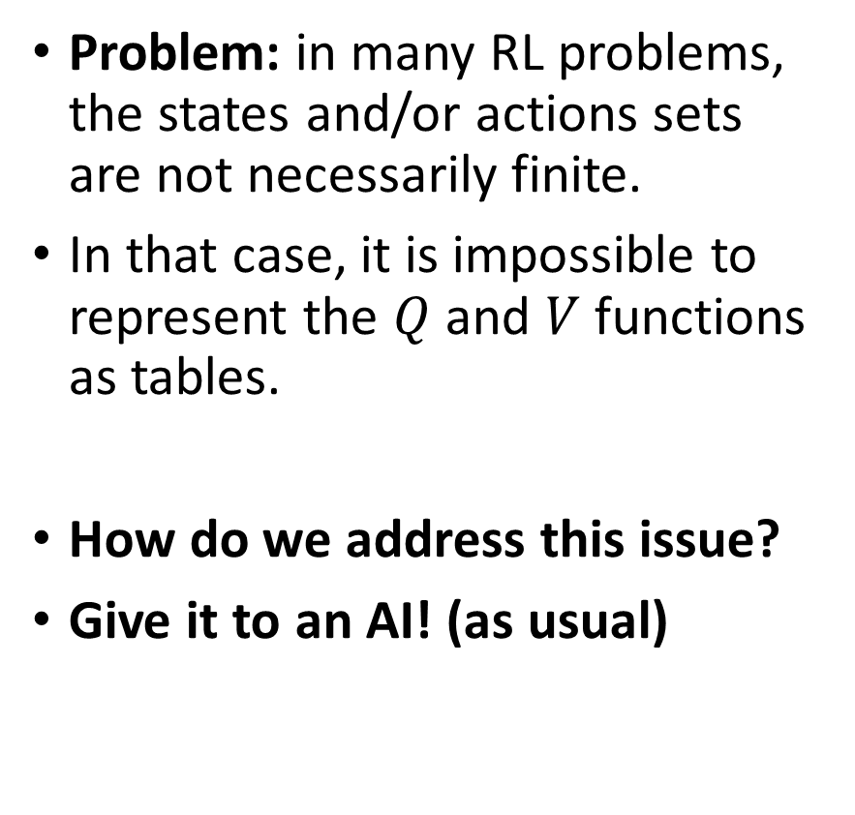
Toy example #3 (shown, but implementation out of the scope of this class)
Problem: in many RL problems, the states and/or actions sets are not necessarily finite.
In that case, it is impossible to represent the $Q$ and $V$ functions as tables.
How do we address this issue?
Give it to an AI! (as usual)

Slide 32
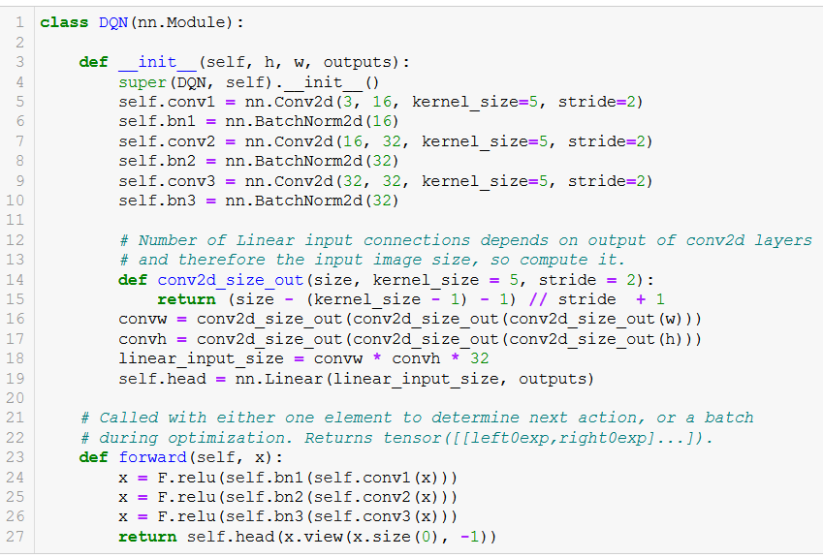
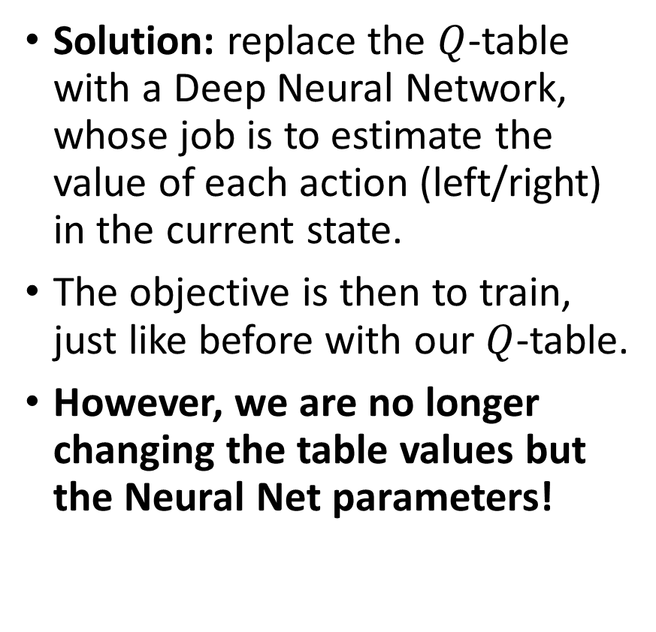
Toy example #3 (shown, but implementation out of the scope of this class)
Solution: replace the $Q$-table with a Deep Neural Network, whose job is to estimate the value of each action (left/right) in the current state.
The objective is then to train, just like before with our $Q$-table.
However, we are no longer changing the table values but the Neural Net parameters!

Slide 33
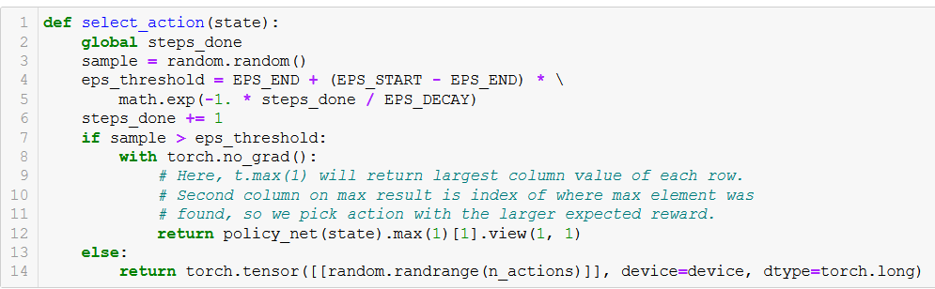
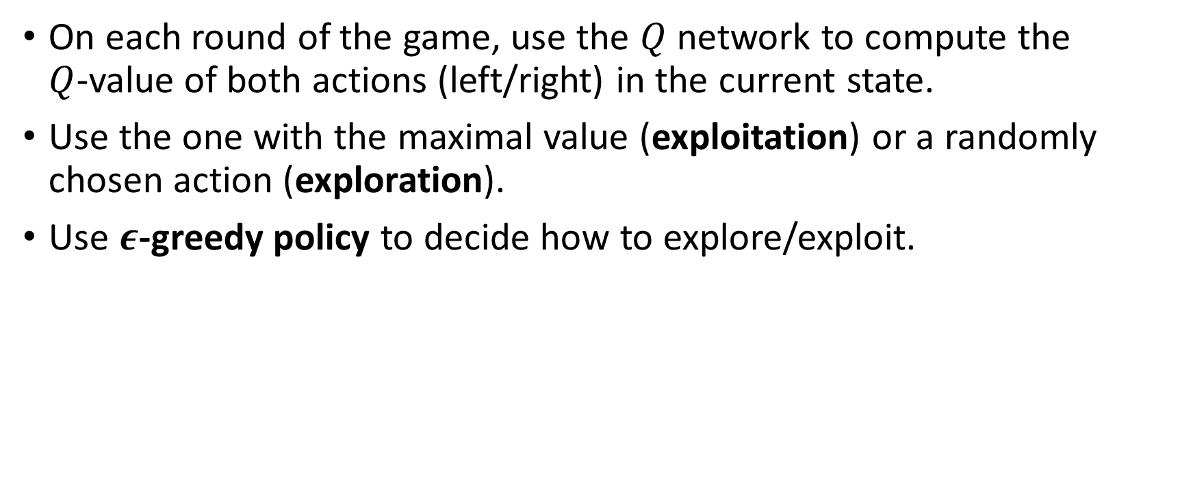
Toy example #3 (shown, but implementation out of the scope of this class)
On each round of the game, use the $Q$ network to compute the $Q$-value of both actions (left/right) in the current state.
Use the one with the maximal value (exploitation) or a randomly chosen action (exploration).
Use $ε$-greedy policy to decide how to explore/exploit.

Slide 34
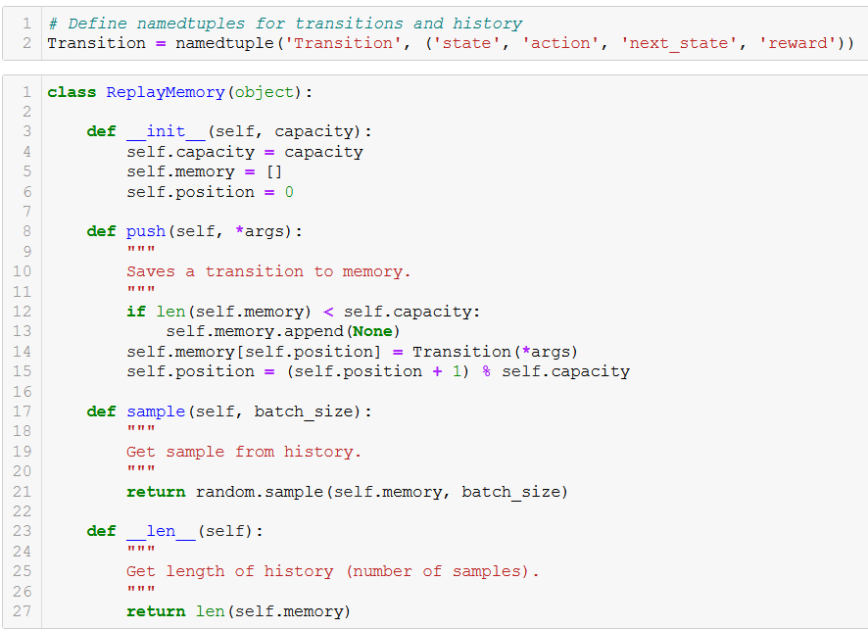
Toy example #3
To train this DNN, we need a dataset of some sort.
Do so by playing the game multiple times and keeping a history of the (state, action, rewards, next_state, done) tuples.
Here, done indicates that the game has ended (out of screen or low angle on pole).
Structure is roughly similar to our dataloaders?

Slide 35
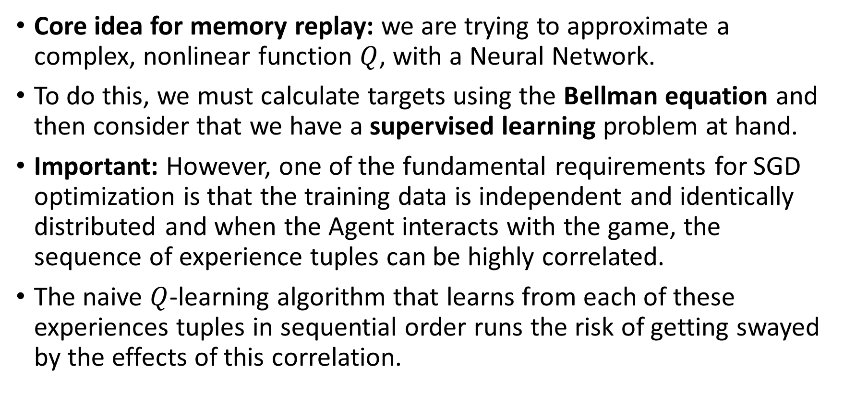
Toy example #3 (shown, but implementation out of the scope of this class)
Core idea for memory replay: we are trying to approximate a complex, nonlinear function $Q$, with a Neural Network.
To do this, we must calculate targets using the Bellman equation and then consider that we have a supervised learning problem at hand.
Important: However, one of the fundamental requirements for SGD optimization is that the training data is independent and identically distributed and when the Agent interacts with the game, the sequence of experience tuples can be highly correlated.
The naive $Q$-learning algorithm that learns from each of these experiences tuples in sequential order runs the risk of getting swayed by the effects of this correlation.

Slide 36
Toy example #3 (shown, but implementation out of the scope of this class)
Definition (experience buffer in RL):
We can prevent action values from oscillating or diverging catastrophically using a large buffer of our past experience and sample training data from it, instead of using our latest experience.
This is called an experience buffer.
The experience buffer contains a collection of experience tuples (state, action, rewards, next_state).
The tuples are gradually added to the buffer as the agents keep on interacting with the game.

Slide 37
Toy example #3 (shown, but implementation out of the scope of this class)
Definition (experience replay):
The simplest implementation is a buffer of fixed size, with new data added to the end of the experience buffer, so that it pushes the oldest experience out of it.
The act of sampling a small batch of tuples from the experience buffer in order to learn is known as experience replay.
In addition to breaking harmful correlations, experience replay allows us to learn more from individual tuples multiple times, recall rare occurrences, and in general make better use of our experience.

Slide 38
Toy example #3 (shown, but implementation out of the scope of this class)
To train this DNN, we need a dataset of some sort.
Do so by playing the game multiple times and keeping a history of the (state, action, rewards, next_state, done) tuples.
Here, done indicates that the game has ended (out of screen or low angle on pole).
Structure is roughly similar to our dataloaders?

Slide 39
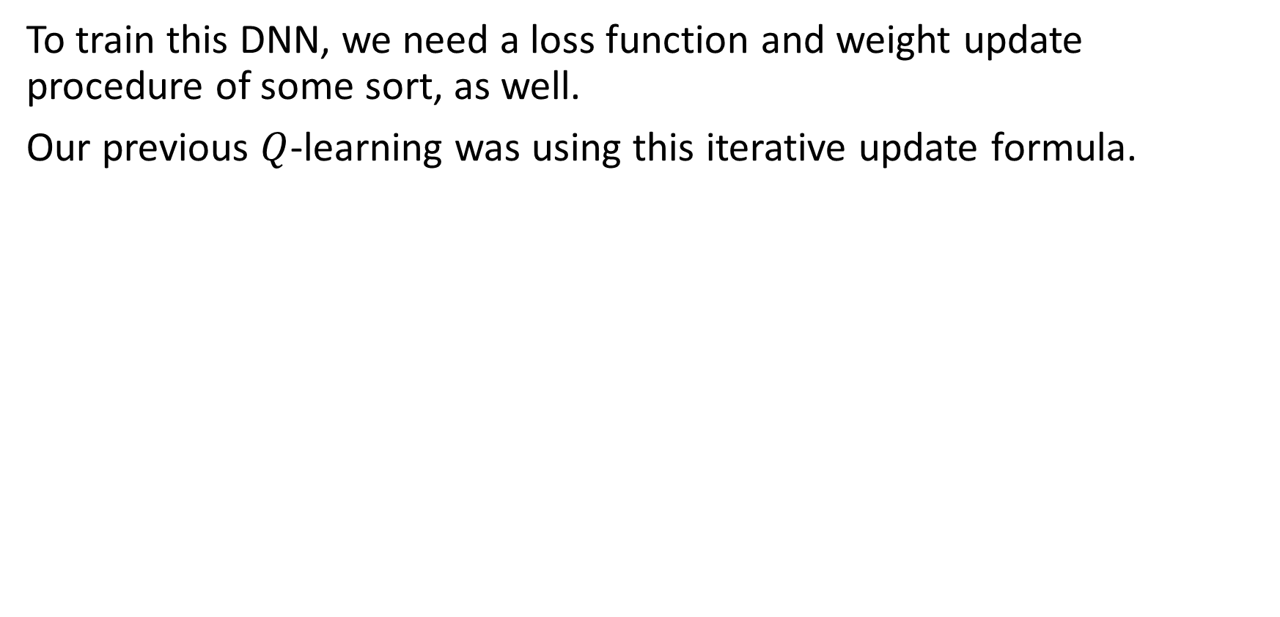
Toy example #3 (shown, but implementation out of the scope of this class)
To train this DNN, we need a loss function and weight update procedure of some sort, as well.
Our previous $Q$-learning was using this iterative update formula.

Slide 40
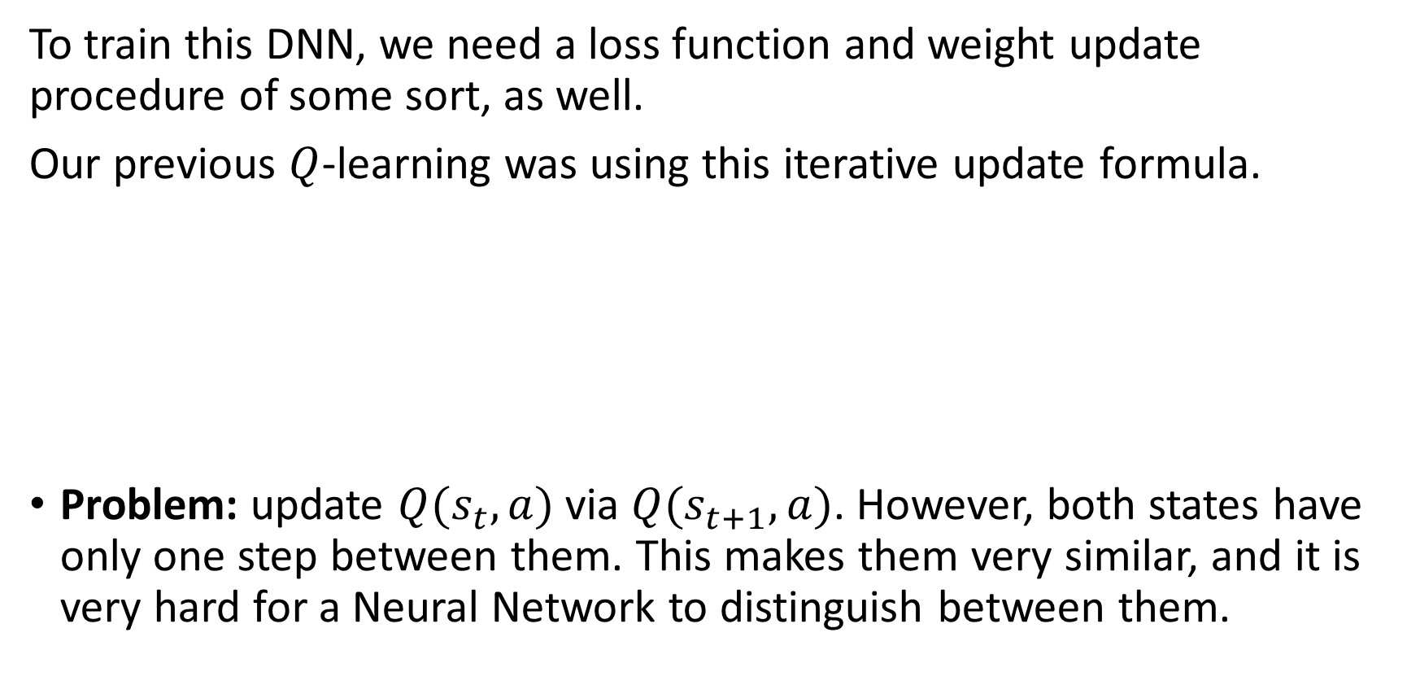
Toy example #3 (shown, but implementation out of the scope of this class)
To train this DNN, we need a loss function and weight update procedure of some sort, as well.
Our previous $Q$-learning was using this iterative update formula.
Problem: update $Q(s_{t}, a)$ via $Q(s_{t+1}, a)$. However, both states have only one step between them. This makes them very similar, and it is very hard for a Neural Network to distinguish between them.

Slide 41
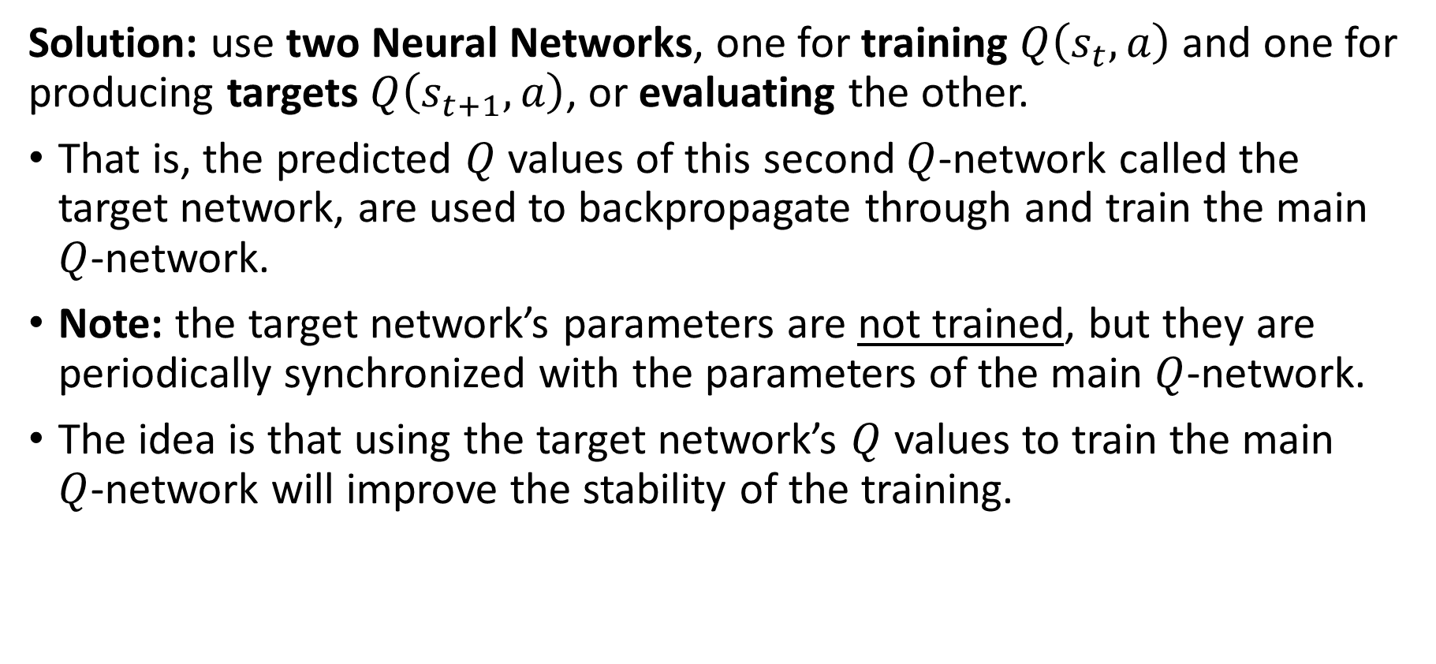
Toy example #3 (shown, but implementation out of the scope of this class)
Solution: use two Neural Networks, one for training $Q\left(s_{t}, a\right)$ and one for producing targets $Q\left(s_{t+1}, a\right)$, or evaluating the other.
That is, the predicted $Q$ values of this second $Q$-network called the target network, are used to backpropagate through and train the main $Q$-network.
Note: the target network’s parameters are not trained, but they are periodically synchronized with the parameters of the main $Q$-network.
The idea is that using the target network’s $Q$ values to train the main $Q$-network will improve the stability of the training.

Slide 42
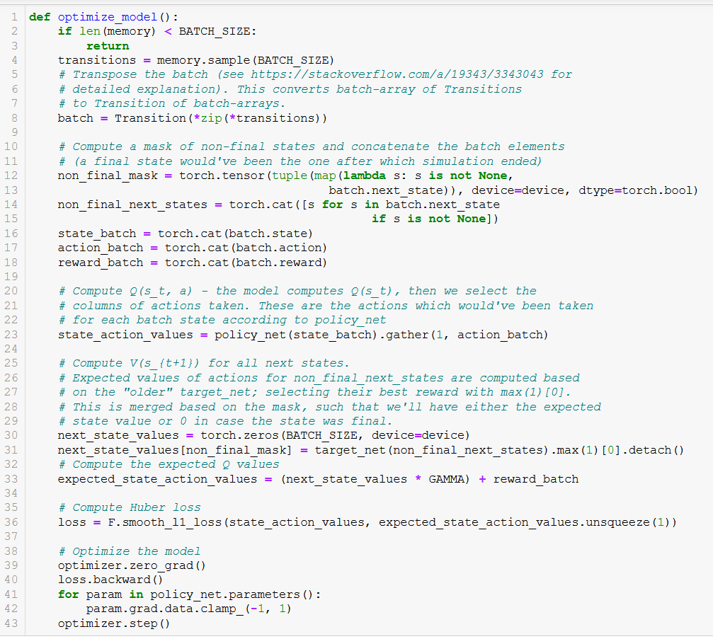

Slide 43
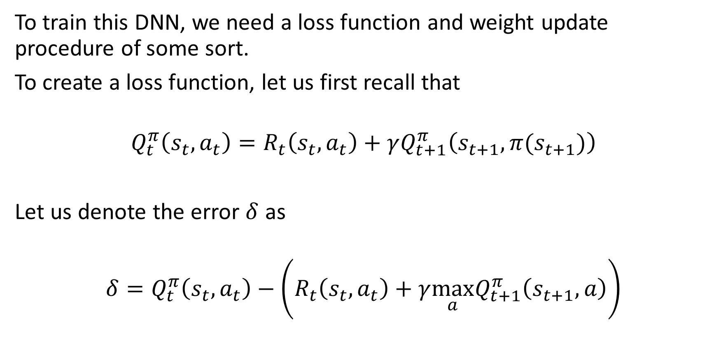
Toy example #3 (shown, but implementation out of the scope of this class)
To train this DNN, we need a loss function and weight update procedure of some sort.
To create a loss function, let us first recall that
$$Q_{t}^{π}\left(s_{t}, a_{t}\right)=R_{t}\left(s_{t},a_{t}\right)+γQ_{t+1}^{π}\left(s_{t+1},π(s_{t+1})\right)$$
Let us denote the error $δ$ as
$$δ=Q_{t}^{π}\left(s_{t}, a_{t}\right)−\left(R_{t}\left(s_{t},a_{t}\right)+γ{\max_{a}Q}_{t+1}^{π}\left(s_{t+1},a\right)\right)$$

Slide 44
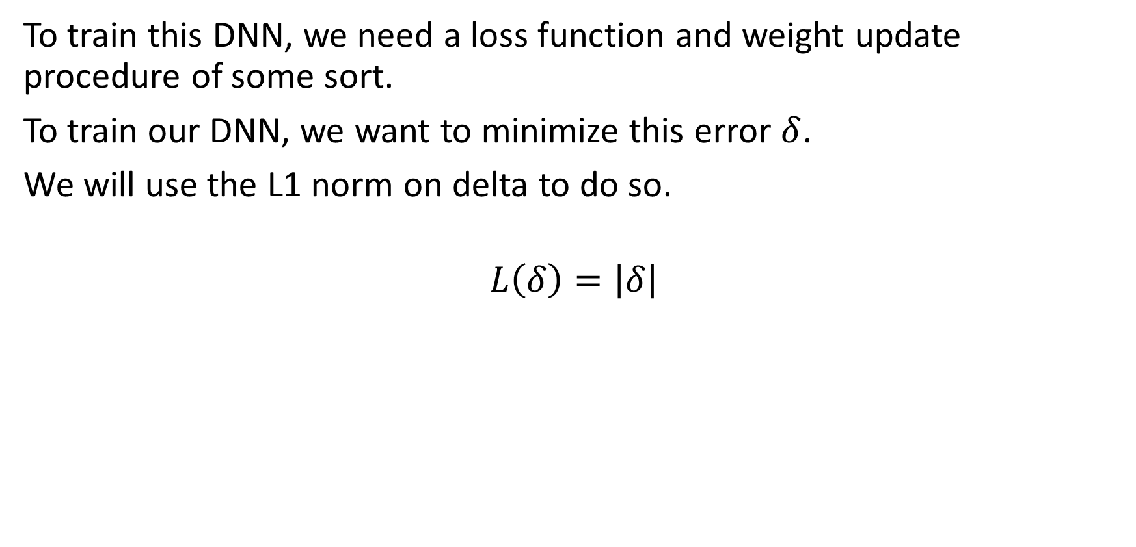
Toy example #3 (shown, but implementation out of the scope of this class)
To train this DNN, we need a loss function and weight update procedure of some sort.
To train our DNN, we want to minimize this error $δ$.
We will use the L1 norm on delta to do so.
$$L\left(δ\right)=\left|δ\right|$$

Slide 45
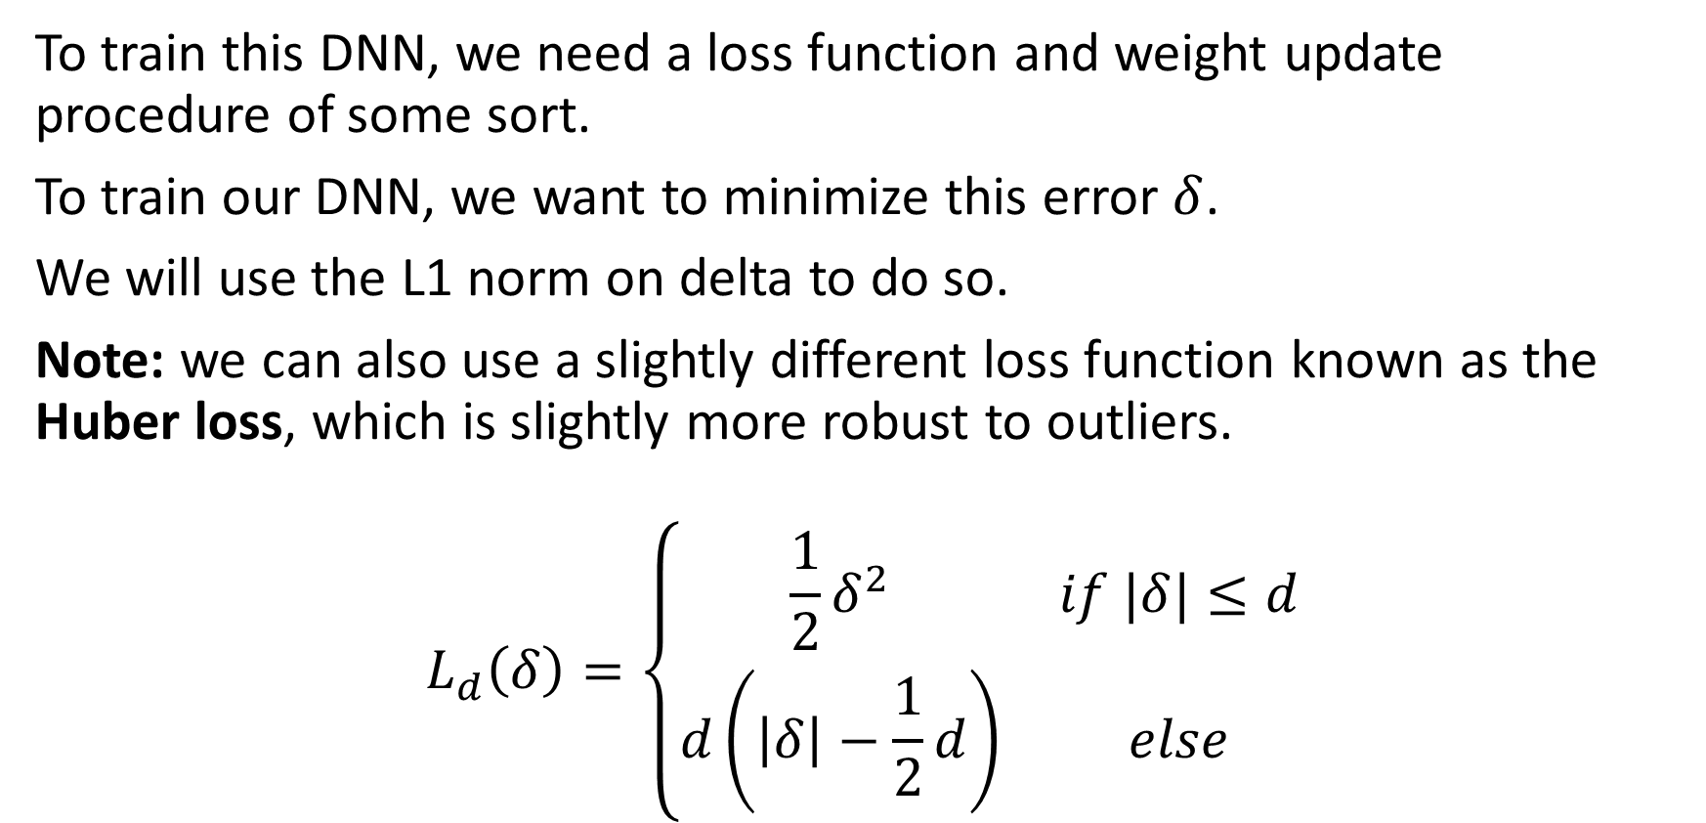
Toy example #3 (shown, but implementation out of the scope of this class)
To train this DNN, we need a loss function and weight update procedure of some sort.
To train our DNN, we want to minimize this error $δ$.
We will use the L1 norm on delta to do so.
Note: we can also use a slightly different loss function known as the Huber loss, which is slightly more robust to outliers.
$$L_{d}\left(δ\right)=\left\{\begin{matrix}\frac{1}{2}δ^{2} & if |δ|≤d \\ d\left(\left|δ\right|−\frac{1}{2}d\right) & else\end{matrix}\right.$$

Slide 47
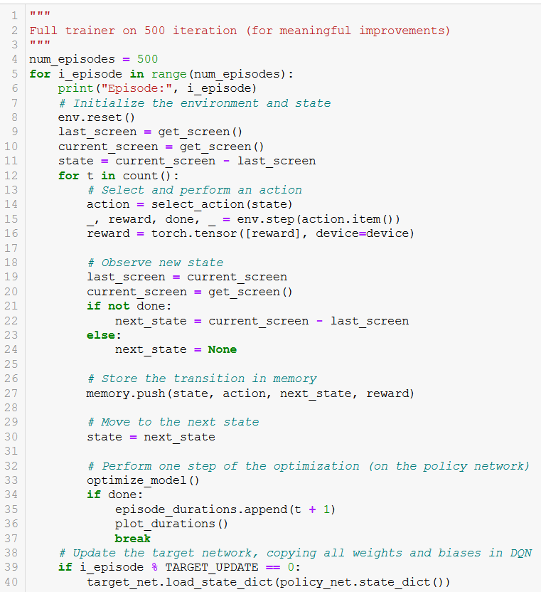
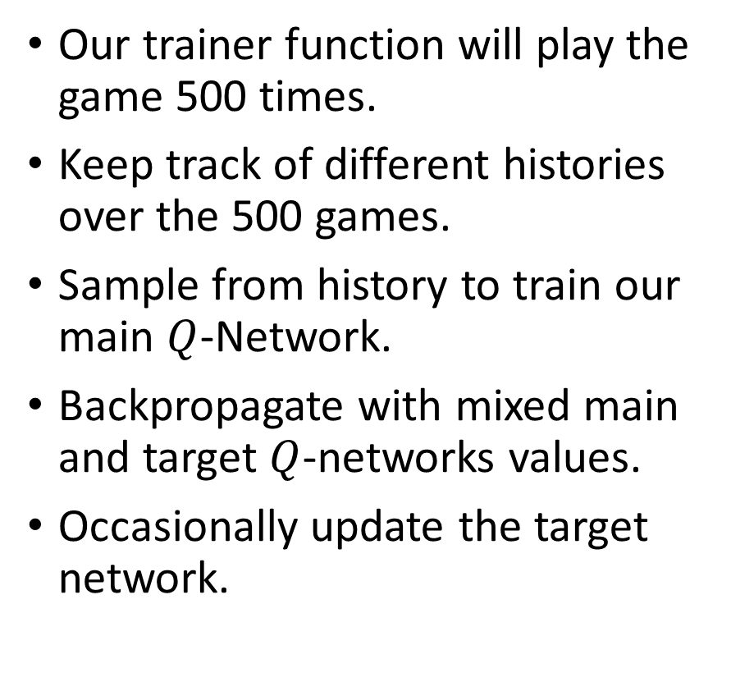
Trainer function
Our trainer function will play the game 500 times.
Keep track of different histories over the 500 games.
Sample from history to train our main $Q$-Network.
Backpropagate with mixed main and target $Q$-networks values.
Occasionally update the target network.

Slide 48
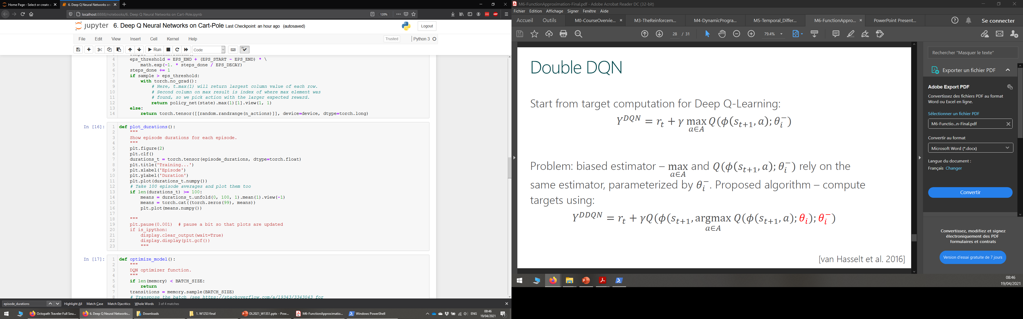
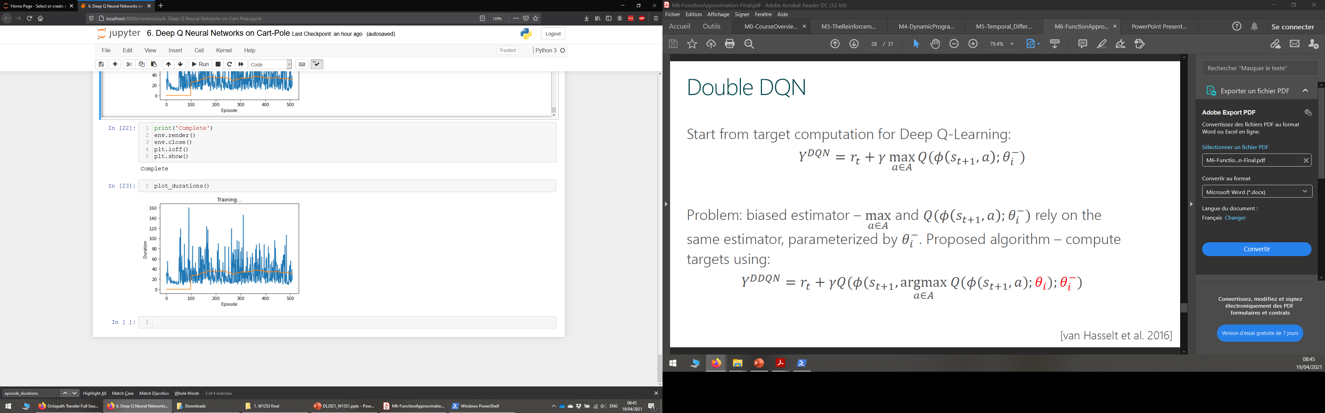
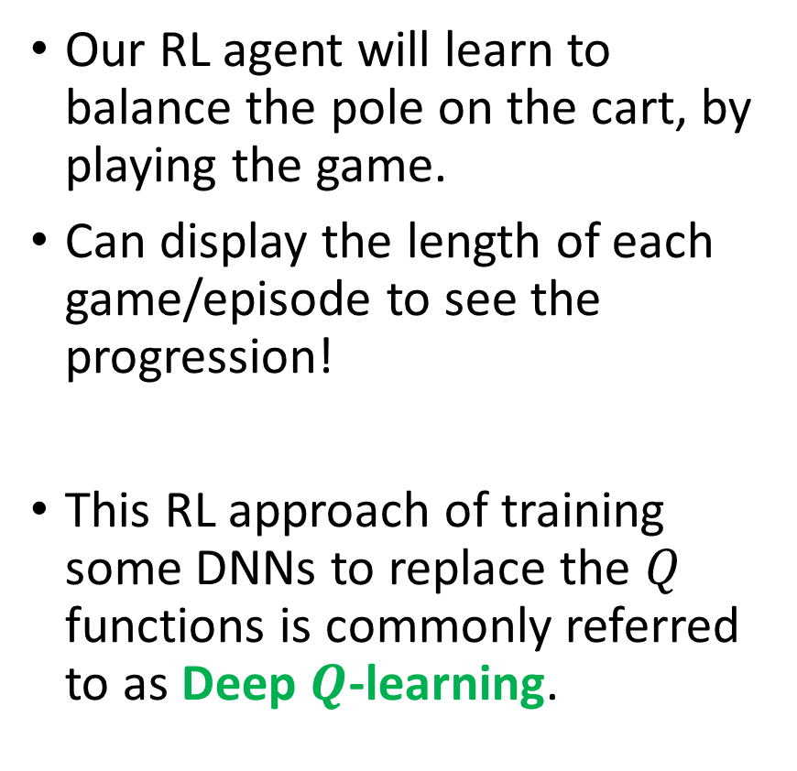
Training results
Our RL agent will learn to balance the pole on the cart, by playing the game.
Can display the length of each game/episode to see the progression!
This RL approach of training some DNNs to replace the $Q$ functions is commonly referred to as Deep $Q$-learning.

Slide 49
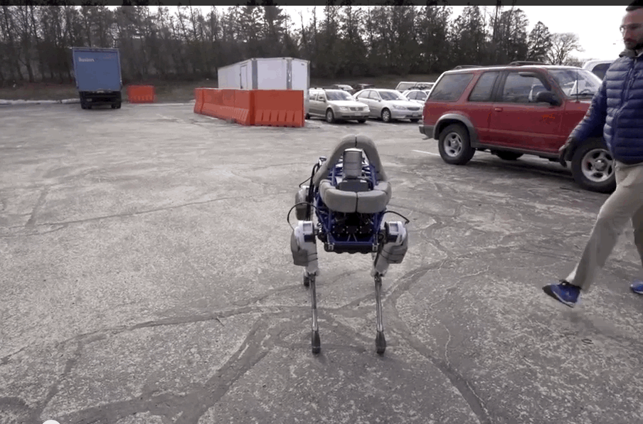
Following this cart-pole balance idea…
Train an AI to keep a robot on its feet, despite some “minor environment perturbations” (a polite way of saying you kick the hell out of the robot for fun).
Video: https://www.youtube.com/watch?v=NR32ULxbjYc
BostonDynamics blog: https://blog.bostondynamics.com/

Slide 50
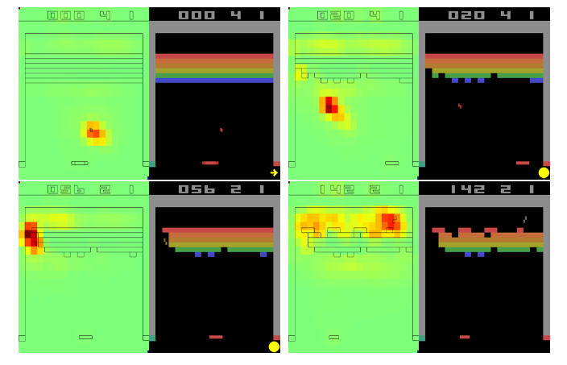
Following this idea of using computer vision to identify state and act…
Train an AI to play video games with Deep Reinforcement Learning (Mnih, 2013)!
Paper: https://www.cs.toronto.edu/~vmnih/docs/dqn.pdf
Video: https://www.youtube.com/watch?v=TmPfTpjtdgg

Slide 51
Conclusion
What is Deep Q Learning? And which problem does it address?
What is a trainer and a main Q-network? What is the interleaved training for Deep Q learning?
What are actor-critic learning methods? And which problems do these approaches address?
What are more advanced problems in RL?
Markov states
Partially observable environment
SARSA
Non-stationary problems

Slide 52
Learn more about these topics
Out of class, for those of you who are curious
[TheBibleOfRL] R. Sutton et al., “Reinforcement learning: An Introduction, 2nd edition”, 2018. http://www.incompleteideas.net/book/RLbook2020.pdf
[Mnih2018] Mnih et al., “Playing Atari with Deep Reinforcement Learning”, 2018. https://arxiv.org/abs/1312.5602
The BostonDynamics blog (some more robots updates!) https://blog.bostondynamics.com/

Slide 53
Learn more about these topics
Tracking important names (Track their works and follow them on Scholar, Twitter, or whatever works for you!)
Richard Sutton: Professor at University of Alberta, also DeepMind. Co-author of the Bible of RL (possibly most influential professor in the field of RL). https://scholar.google.ca/citations?user=6m4wv6gAAAAJ&hl=en https://www.ualberta.ca/admissions-programs/online-courses/reinforcement-learning/index.html http://www.incompleteideas.net/book/RLbook2020.pdf
Andrew Barto: Professor at University of Massachussets. Co-author of the Bible of RL. https://people.cs.umass.edu/~barto/ https://scholar.google.com/citations?user=CMIgrCgAAAAJ&hl=en

Slide 54
Learn more about these topics
Tracking important names (Track their works and follow them on Scholar, Twitter, or whatever works for you!)
David Sliver: Reasearcher at DeepMind, Adjunct Professor at University College London (?). Inventor of Alpha GO AIs, has a fantastic course on RL as well. https://www.davidsilver.uk/ https://scholar.google.com/citations?user=-8DNE4UAAAAJ&hl=en https://www.davidsilver.uk/teaching/
Volodymir Mnih: Reasearcher at DeepMind. http://www.cs.toronto.edu/~vmnih https://scholar.google.com/citations?user=rLdfJ1gAAAAJ&hl=en

Slide 55
Learn more about these topics
Out of class, for those of you who are curious
[AlphaGo] How AlphaGo was created using DL and RL. https://jonathan-hui.medium.com/alphago-zero-a-game-changer-14ef6e45eba5
Full Alpha Go movie on DeepMind’s Youtube channel. Award-winning movie, pretty cool. https://www.youtube.com/watch?v=WXuK6gekU1Y

Slide 56
Out-of-scope stuff: used to be the third lecture of RL, but no longer is…
In case you are curious about more advanced concepts in RL!

Slide 57
A quick word on actor-critic methods (more advanced stuff, out of scope)
In Deep Q-learning, we realized that most RL problems cannot have their Q functions computed easily.
We then replaced the Q function with a Deep Neural Network to approximate this function.

Slide 58

A quick word on actor-critic methods (more advanced stuff, out of scope)
In Deep Q-learning, we realized that most RL problems cannot have their Q functions computed easily.
We then replaced the Q function with a Deep Neural Network to approximate this function.
Additional suggestion: Can the reward function always be computed?

Slide 59
A quick word on actor-critic methods (more advanced stuff, out of scope)
In Deep Q-learning, we realized that most RL problems cannot have their Q functions computed easily.
We then replaced the Q function with a Deep Neural Network to approximate this function.
Additional suggestion: Can the reward function always be computed?
→ Replace more elements of the RL system with Deep Neural Networks.

Slide 60
A quick word on actor-critic methods (more advanced stuff, out of scope)
Definition (actor-critic):
Actor-critic algorithms consist of two components.
Actor: a DNN, whose purpose is to produce actions in response to given states, i.e. a policy. Can be trained as in Deep Q-learning.

Slide 61
A quick word on actor-critic methods (more advanced stuff, out of scope)
Definition (actor-critic):
Actor-critic algorithms consist of two components.
Actor: a DNN, whose purpose is to produce actions in response to given states, i.e. a policy. Can be trained as in Deep Q-learning.
Critic: a DNN, whose purpose is to evaluate the quality of the selected actions and suggesting directions for improvement, by defining a reward function or a Q function.

Slide 62
A quick word on actor-critic methods (more advanced stuff, out of scope)
Definition (actor-critic):
Actor-critic algorithms consist of two components.
Actor: a DNN, whose purpose is to produce actions in response to given states, i.e. a policy. Can be trained as in Deep Q-learning.
Critic: a DNN, whose purpose is to evaluate the quality of the selected actions and suggesting directions for improvement, by defining a reward function or a Q function.
In a sense, similar to the Generator-Critic pair of the Wasserstein GANs!
Generator: produce fake images
Critic: evaluate said images

Slide 63


From Deep Q learning to actor-critic

Slide 64

Markov Decision Processes (more advanced stuff, out of scope)
Sometimes, the transition from state $s_{t}$ to next state $s_{t+1}$, following from action $a_{t}$, will not always be deterministic.
In that case, we have to define some system dynamics, as below.
$$p\left(s^{′},r | s,a\right)=P\left(s_{t+1}=s^{′}, r_{t}=r \right|{ s}_{t}=s, a_{t}=a)$$
Similar to our previous problem, with a stochastic twist.
It is called a Markov Decision Process (MDP) problem.

Slide 65

Markov Decision Processes (more advanced stuff, out of scope)
In MDPs, all the previous formulas have to be reworked to account for the stochastic aspect of the problem.
$$V_{t}^{π}\left(s\right)=E\left[G_{t} \right| s_{t}=s]$$
$$Q_{t}^{π}\left(s,a\right)=E\left[G_{t} \right| s_{t}=s, a_{t}=a]$$
In MDPs, the Q and V functions can still be learned from experience, but their Bellman equations change slightly, to account for the stochasticity.

Slide 66

Markov Decision Processes (more advanced stuff, out of scope)
In MDPs, the Q and V functions can still be learned from experience, but their Bellman equations change slightly, to account for the stochasticity.
$$V_{t}^{π}\left(s\right)=E\left[G_{t} \right| s_{t}=s]$$
$$V_{t}^{π}\left(s\right)=E\left[R_{t}+γG_{t+1} \right| s_{t}=s]$$
$$V_{t}^{π}\left(s\right)=\sum_{a}{π\left(a \right| s)\sum_{s′}{\sum_{r}{p\left(s^{′}, r \right| s,a) \left[r+γE\left[G_{t+1} | s_{t+1=s′}\right]\right]}}}$$
$$V_{t}^{π}\left(s\right)=\sum_{a}{π\left(a \right| s)\sum_{s′}{\sum_{r}{p\left(s^{′}, r \right| s,a) \left[r+γV_{t+1}^{π}\left(s′\right)\right]}}}$$

Slide 67

Partially observable MDP (more advanced stuff, out of scope)
Definition (partially observable Markov Decision Process):
In our original RL framework, we assumed that the agent was seeing the exact state of the game at each time t.
This is also an assumption, which can be challenged.
State $s_{t}$ is ground truth, agent received observation $o_{t}$ and uses to decide on action.
State
Take action based on observation
Reward is given for taking action in said state
Environment changes and a new state is produced
Observation is made by agent

Slide 68
Partially observable MDP (more advanced stuff, out of scope)
Definition (partially observable Markov Decision Process):
The agent then decides on an observation made of the actual (hidden) state.
This is called a partially observable Markov Decision Process.
Agent will have to learn to observe on top of acting properly (e.g. card game, with opponent hiding his/her hand).
State
Take action based on observation
Reward is given for taking action in said state
Environment changes and a new state is produced
Observation is made by agent

Slide 69
State-Action-Reward-State-Action or SARSA (more advanced stuff, out of scope)
In many problems, e.g. Go, the new state seen by a given player is not the result of the action of the said player.
Instead, another player has to act first, before a new state is produced.

Slide 70
State-Action-Reward-State-Action or SARSA (more advanced stuff, out of scope)
In many problems, e.g. Go, the new state seen by a given player is not the result of the action of the said player.
Instead, another player has to act first, before a new state is produced.
This adds steps to the cycle, which becomes (state, action, reward, state_P2, action_P2).
Board state
P1 will take action based on state
Reward is given to P1 for taking action in said state
Environment changes and a new state is produced for P2
P2 will take action based on state
A new state will be produced for P1

Slide 71
State-Action-Reward-State-Action or SARSA (more advanced stuff, out of scope)
This is called a State-Action-Reward-State-Action (SARSA) type of problem.
In that case the agent has to learn how to play, but also has to learn how another player might respond to its actions.
RL meets game theory!
Board state
P1 will take action based on state
Reward is given to P1 for taking action in said state
Environment changes and a new state is produced for P2
P2 will take action based on state
A new state will be produced for P1

